Slide 1





Designing a multipurpose constructicon resource: classification, architecture, and use
Laura A. Janda
Anna Endresen Valentina Zhukova

Slide 2



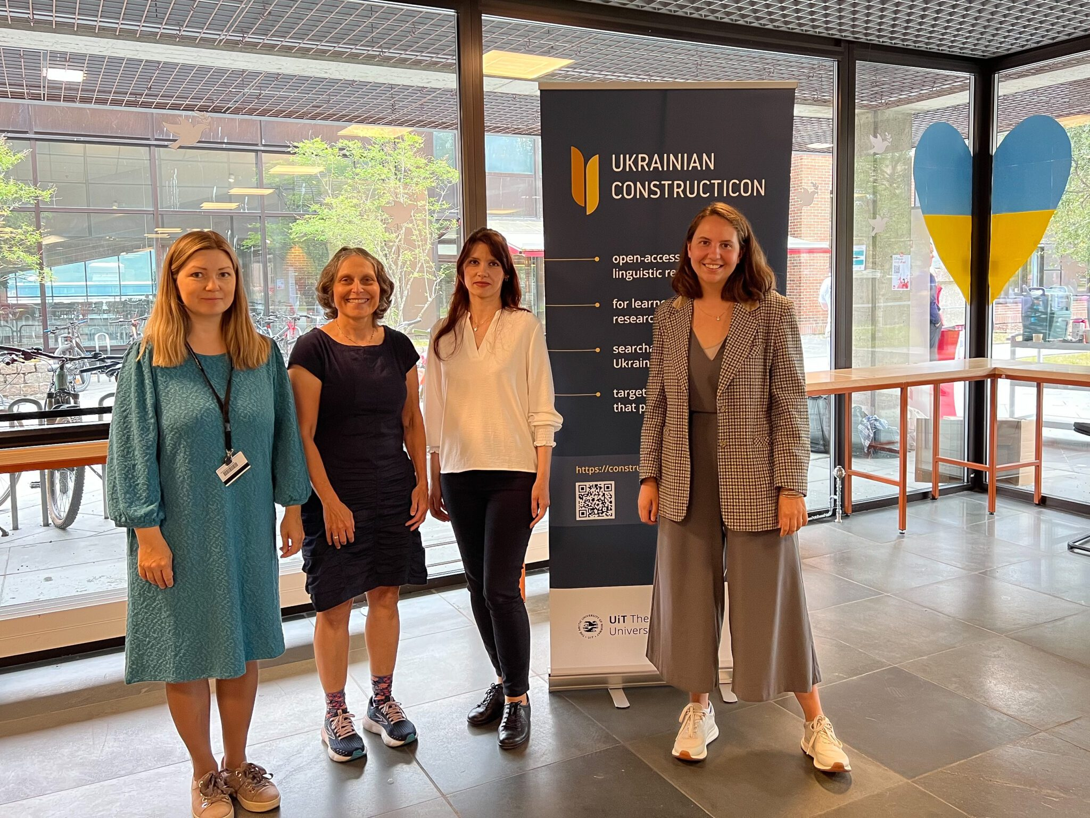
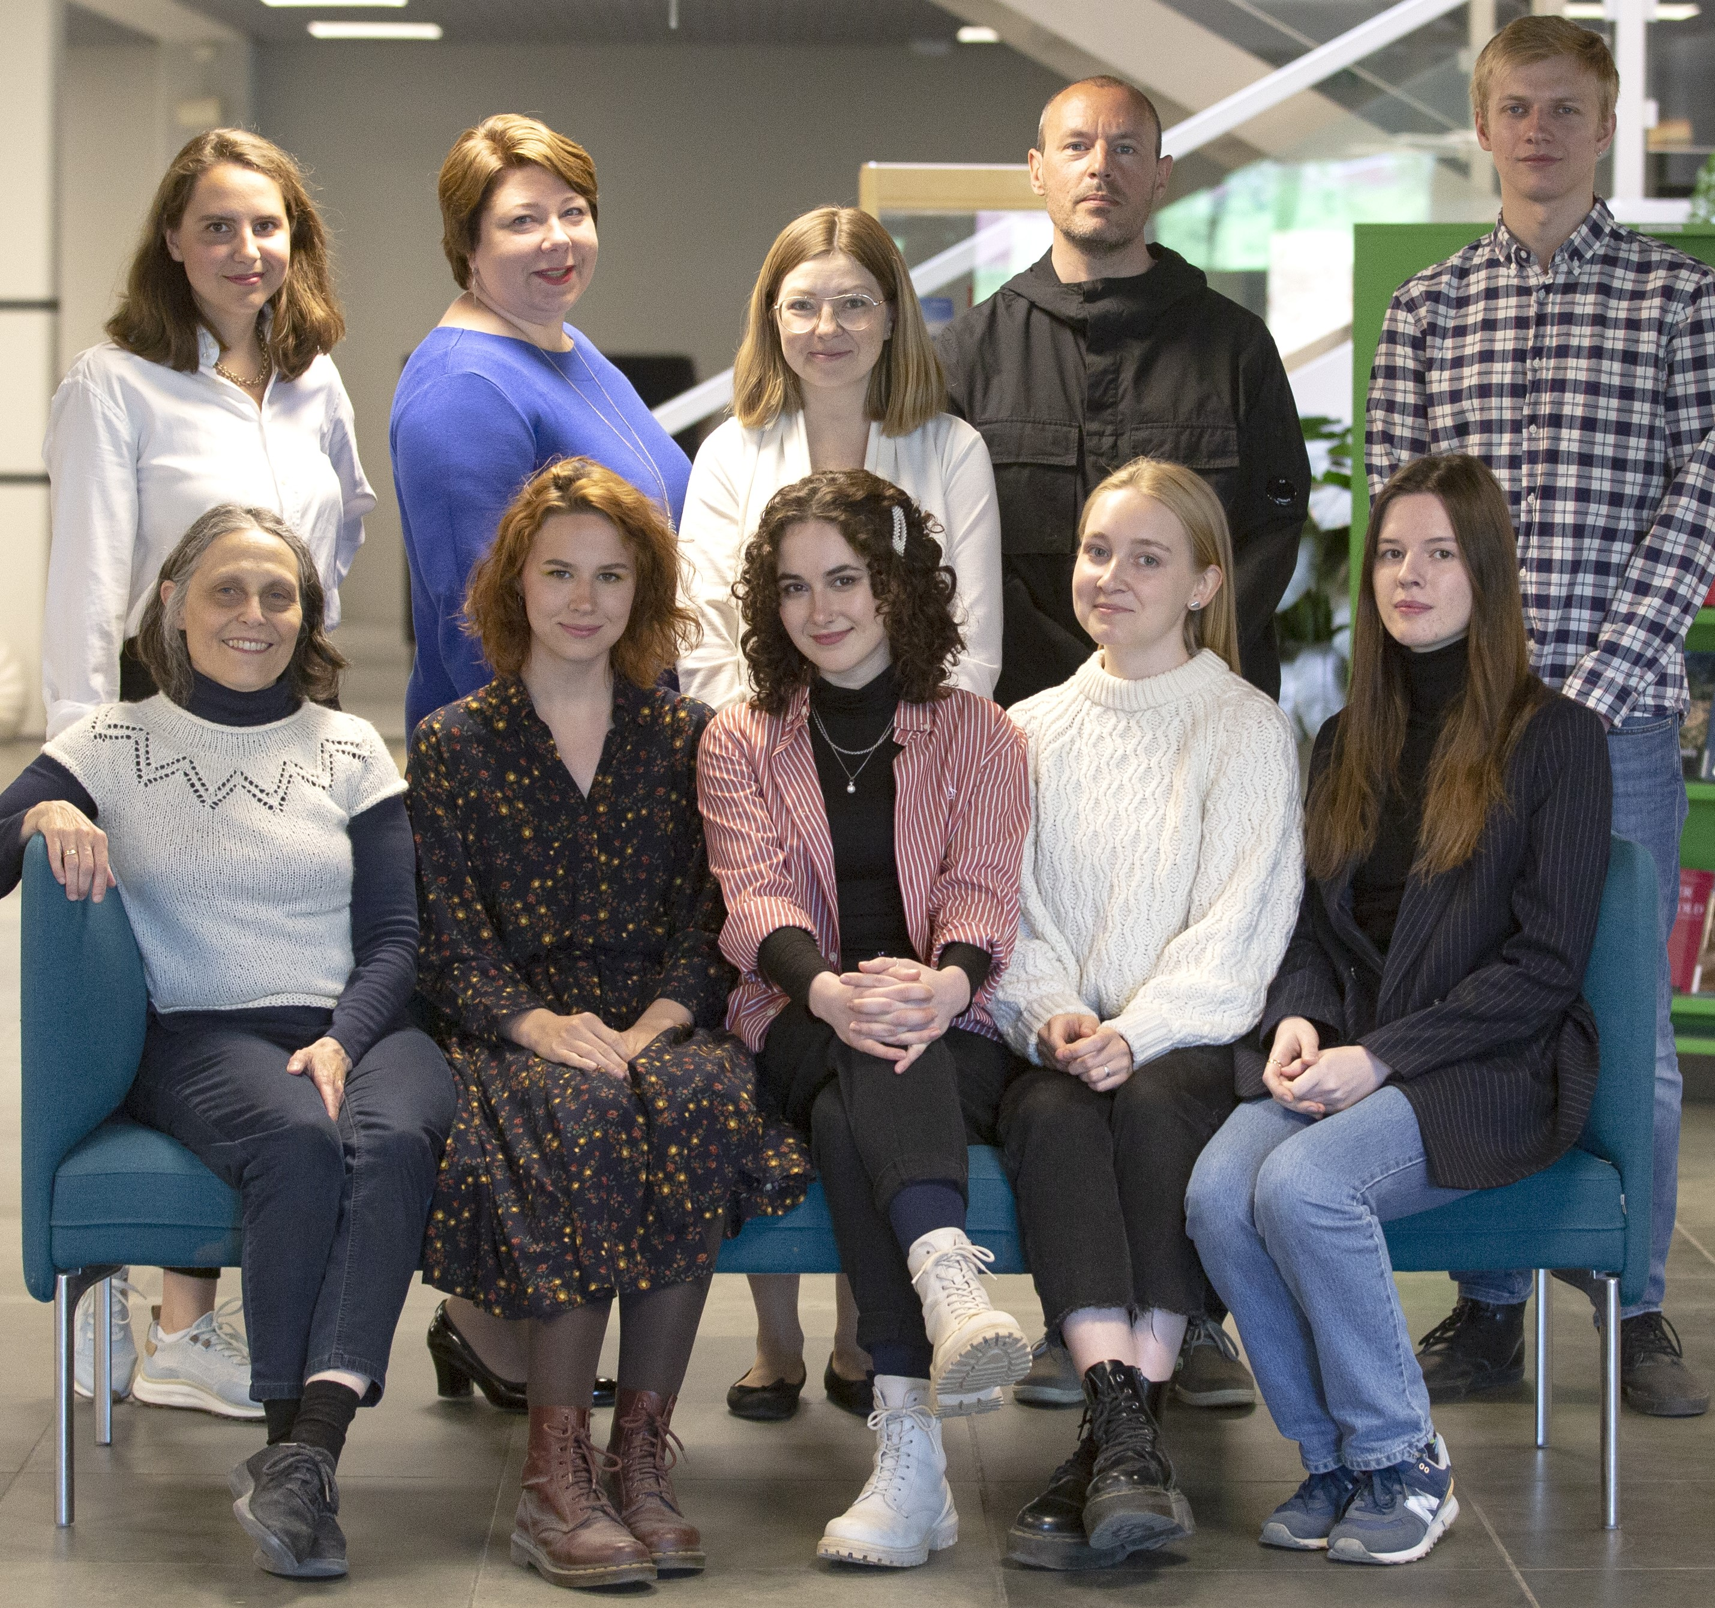




Tromsø Constructicon Lab (ConLab): projects
'
The Persian Constructicon
2023
2024
2016
2023
The Norwegian Constructicon
The Hill Mari
Constructicon
2022
In this talk we will focus on the Russian Constructicon

Slide 3
Overview
Definitions: construction, constructicon
Selection and collection of constructions
Architecture of Russian Constructicon
Classification of constructions
Use of Russian Constructicon
Further directions

Slide 4
Definitions: construction, constructicon

Slide 5





What is a construction?
Construction Grammar theory: A grammatical construction is
a recurrent conventional pairing of form and meaning (or function) learned in the process of language use
the central unit of language structure and description
Fillmore et al. 1988
Croft 2001
Langacker 2008
Haspelmath 2023
Goldberg 1995, 2006, 2013, 2024

Slide 6
What is a construction? Evolving understanding of the phenomenon
Goldberg 1995: 4
“Phrasal patterns are considered constructions if something about their form or meaning is not strictly predictable from the properties of their component parts or from other constructions”.
Goldberg 2006: 5
“Any linguistic pattern is recognized as a construction as long as some aspect of its form or function is not strictly predictable from its components parts or from other constructions recognized to exist. In addition, patterns are stored as constructions even if they are fully predictable as long as they occur with sufficient frequency.”
“Any conventionalized form-meaning pairing in a language, at any level of complexity, from morpheme through lexeme through phrase to discourse structure.”
non-compositional
non-compositional or compositional, frequent
any meaningful unit of a language
Notes:
Compositionality is a scale.
Goldberg, A. 2006. Constructions at work: The nature of generalizations in language. Oxford U Press.
Goldberg, A. E., & Herbst, T. (2021). The nice-of-you construction and its fragments. Linguistics, 59(1), 285-318. https://doi.org/10.1515/ling-2020-0274

Slide 7
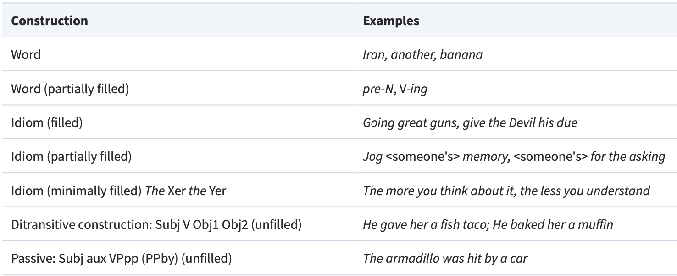
What is a construction? Examples at various levels of complexity from Goldberg 2013

Slide 8
What is a constructicon?
Fillmore (1988: 37) “[t]he grammar of a language can be seen as a repertory of constructions”
Goldberg’s (2006: Chapter 8) observation that constructions are related to each other in radial category networks
Goldberg (2024: 1) “language is comprised of a dynamic network of CONSTRUCTIONS, at varying levels of complexity and abstraction”
English Subject Auxiliary Inversion family of constructions
(Goldberg 2006)
Notes:
Two ideas have been crucial for us: First, as Fillmore states it, the grammar of a language can be seen as a repertory of constructions, and Second, as it was shown by Adele Goldberg, constructions are related to each other and form families, structured as radial networks. Here on the slide you can see a family of English constructions that feature subject auxiliary inversion, explored in Goldberg 2006.

Slide 9
What is a constructicon?
cf. lex-i-con
Two meanings
ABSTRACT:
The dynamic structured system of the constructions of a language that accounts for the entirety of the language
(Fillmore et al. 1988, Langacker 2008, Lyngfelt et al. 2018, Goldberg & Herbst 2021, Goldberg 2024)
CONCRETE:
A database or resource that represents the constructions of a language
Note alternative terms:
“inventorium” (Haspelmath 2023),
“ConstructionNet” (Weissweiler et al. 2025)

Slide 10
What is a constructicon?
Constructicons for:
English
German
Swedish
Japanese
Brazilian Portuguese
Russian
Norwegian
Italian
Estonian
Ukrainian
Persian
Hill Mari
Slovak (planning stages)
The Russian Constructicon is by far the largest,
with over 4000 constructions
Notes:
The Russian Constructicon is by far the largest, with over 2200 constuctions

Slide 11
Selection and collection of constructions

Slide 12
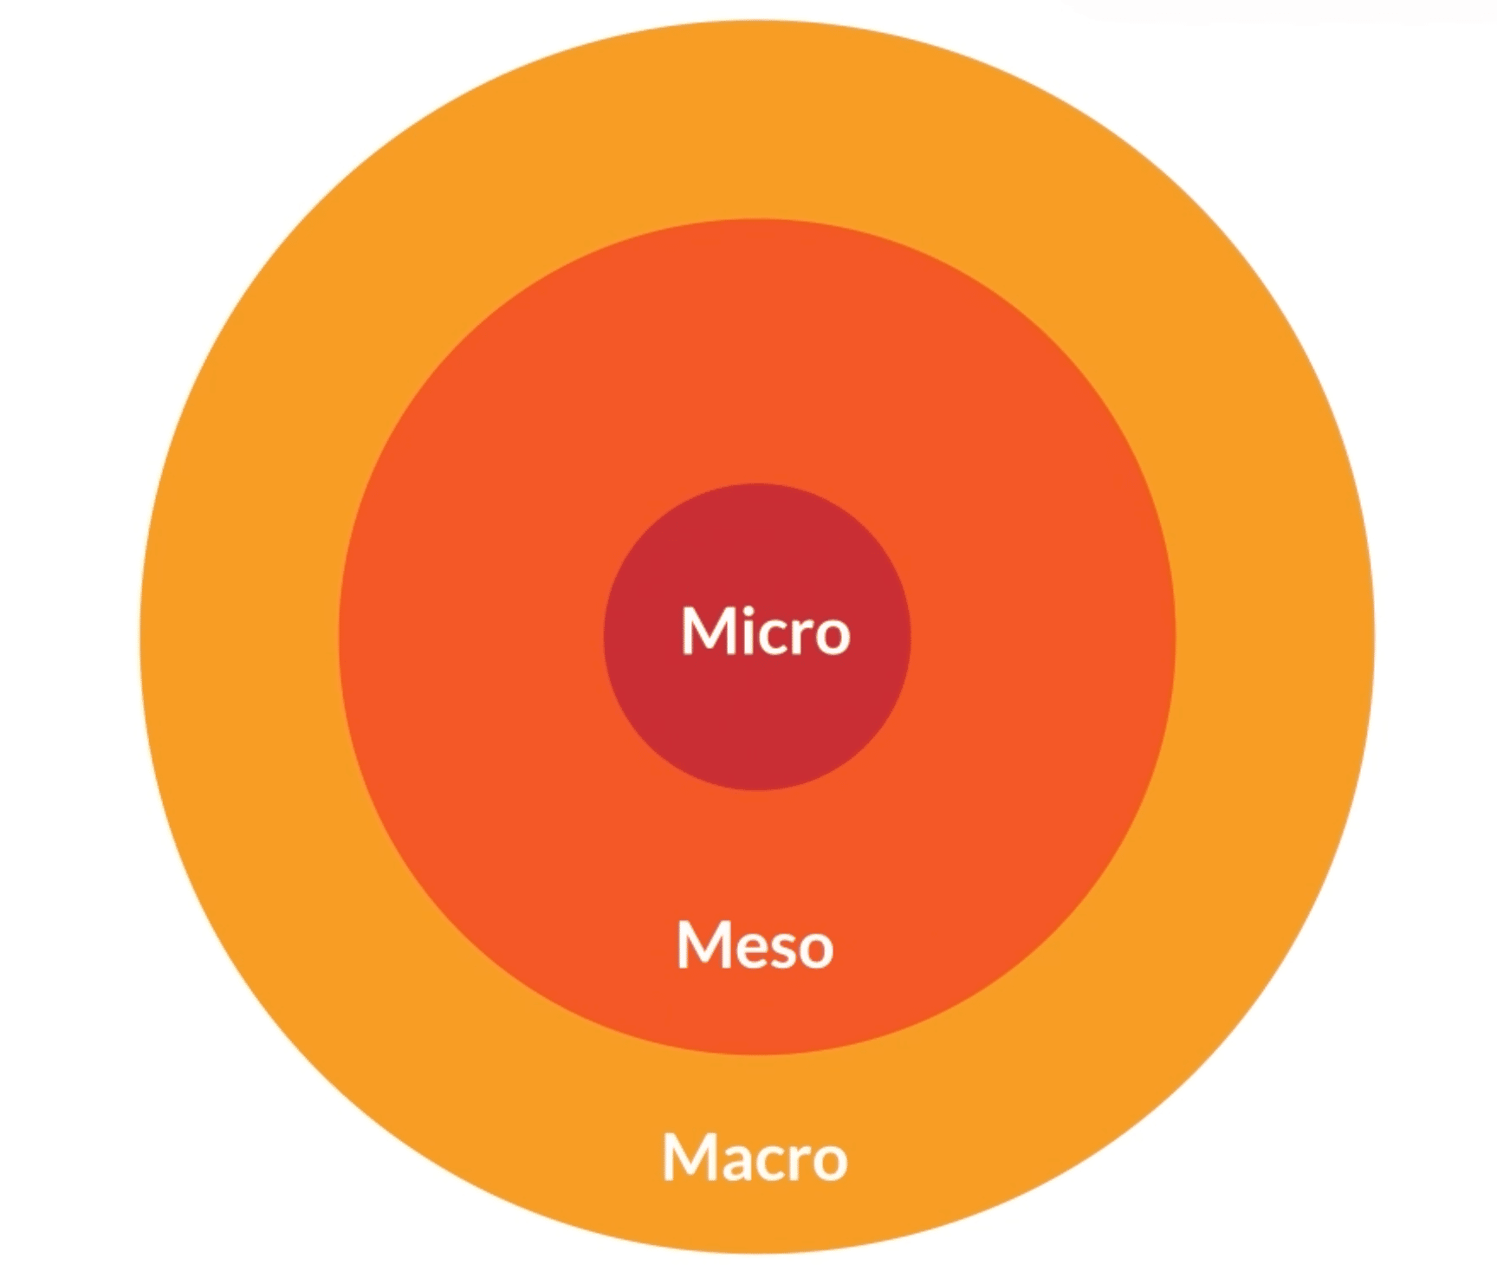
Our priorities
We aim to represent a major portion of the grammar of Russian and take a maximally inclusive "whole-language" approach
But we do not want to reproduce what is already represented elsewhere (e.g. we do not want to include fully schematic "macro-level" cxns or fully idiomatic "micro-level" cxns like idioms and lexemes)
Instead, we focus on multi-word expressions with open slots (meso-level cxns), as they are less reliably represented in standard resources
“partially schematic” cxns (Ehrlemark et al. 2018), often feature non-transparent or irregular syntax and non-compositional semantics
We focus on the most strategic and frequent cxns that are important for L2 learners.
Notes:
The Russian Constructicon is a large-scale resource aiming to represent a major portion of the grammar of Russian.

Slide 13
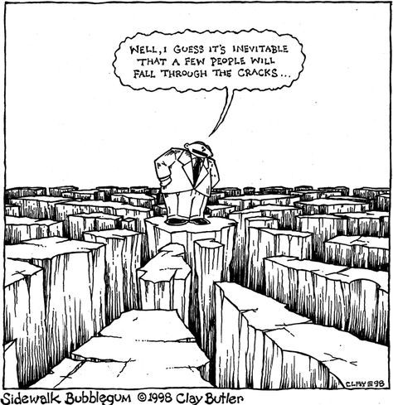
Filling in the gaps
It seems that a few things
just fall through the cracks
Dictionaries, grammars, and textbooks focus primarily on lexemes, lexicalized idioms, inflectional paradigms, and fully schematic grammatical patterns
Multi-word expressions with open slots are less reliably represented in standard resources
TEXTBOOK
PHRASE
BOOK
GLOSSARY
DICTIONARY
REFERENCE
GRAMMAR

Slide 14

Examples of Russian constructions
Morphemes
-t’ = INF
Lexemes
tancevat’ ‘dance’
Multi-word idioms without open slots
tancevat’ ot Adama
‘start from the very beginning’ (lit. ‘dance from Adam’)
Conventional expressions with open slots
VP pod NP-Acc
Ona tancevala pod muzyku
‘She danced to (lit. under) the music’
Larger discourse units
job interview, invitation, request
Our project focuses on these constructions

Slide 15
Our choice of linguistic material
Most constructions we have collected contain several words that form a phrasal unit or a sentence
We focus on the most strategic and frequent constructions important for L2 learners
We prioritize “partially schematic” constructions (Ehrlemark et al. 2018) that
lie between idioms and fully compositional (schematic) expressions
have both an open slot(s) and a fixed lexical part(s)
have certain constraints on the fillers
often feature non-transparent or irregular syntax
often feature non-compositional semantics
ID 33. bez pjati minut NP – Almost a/n X (lit. ‘without five minutes X’)
Fixed lexical part (anchor)
Open slot & restrictions
Notes:
This is a construction that has an open slot for a noun phrase (NP) restricted to nouns signifying a person that will soon change his or her status. This construction also has a fixed part (anchor words) bez pjati minut.

Slide 16
Architecture of Russian Constructicon

Slide 17







Project team
Currently two interfaces (UiT and HSE) exist, but they are sourced from a single database that contains 4001 cxns
Laura Janda
Anna Endresen
Valentina Zhukova
Tore Nesset
Radovan Bast
Daria Mordashova
Ekaterina Rakhilina
Olga Lyashevskaya
Francis Tyers
(+ over 40 students)
UiT version:
https://constructicon.github.io/russian/
N = 4001 constructions
HSE version:
https://constructicon.ruscorpora.ru/
N = 4001 constructions

Slide 18

General information
The Russian Constructicon is a free open access electronic resource giving access to a database of Russian constructions
Searchable according to semantics, anchor words, syntax, CEFR levels
Contains 4001 multi-word grammatical constructions & descriptions of their properties & corpus-based illustrations (open-source, publicly archived data)
Target users:
linguists (researchers of Russian and other Slavic languages, typologists),
students and teachers of Russian as a foreign language (L2 Russian),
specialists in natural language processing (NLP)
Time spent on development: 2016 – 2022 (remaining work is ongoing)
User-friendly interface: https://constructicon.github.io/russian/
Designed to be portable to other languages, reproducible
Notes:
We built the Russian Constructicon as a free open access digital resource, that hosts the database of constructions and provides the users with various search possibilities. Searchable according to semantics, anchor words, syntax.
Today the repository contains over 2,200 constructions accompanied with descriptions of their meanings as well as their structural, syntactic, stilistic properties and authentic corpus-based examples of their use.
This is a multifunctional resource, as it targets at least three categories of users: including professional linguists, learners and instructors of Russian as a foreign language, and specialists in Natural Language Processing (who can use our data to improve existing software applications for automatic translation and spellchecking). The project started in 2016 and its most active phase was completed by 2022, we are currently finishing up some remaining tasks, making all descriptions available. Initially the resource was hosted on the platform made available for us by our colleagues from the Swedish constructicon, Later we created a distinct interface that is hosted on GitHub.

Slide 19
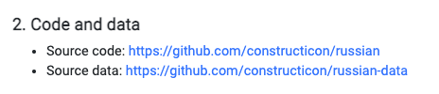
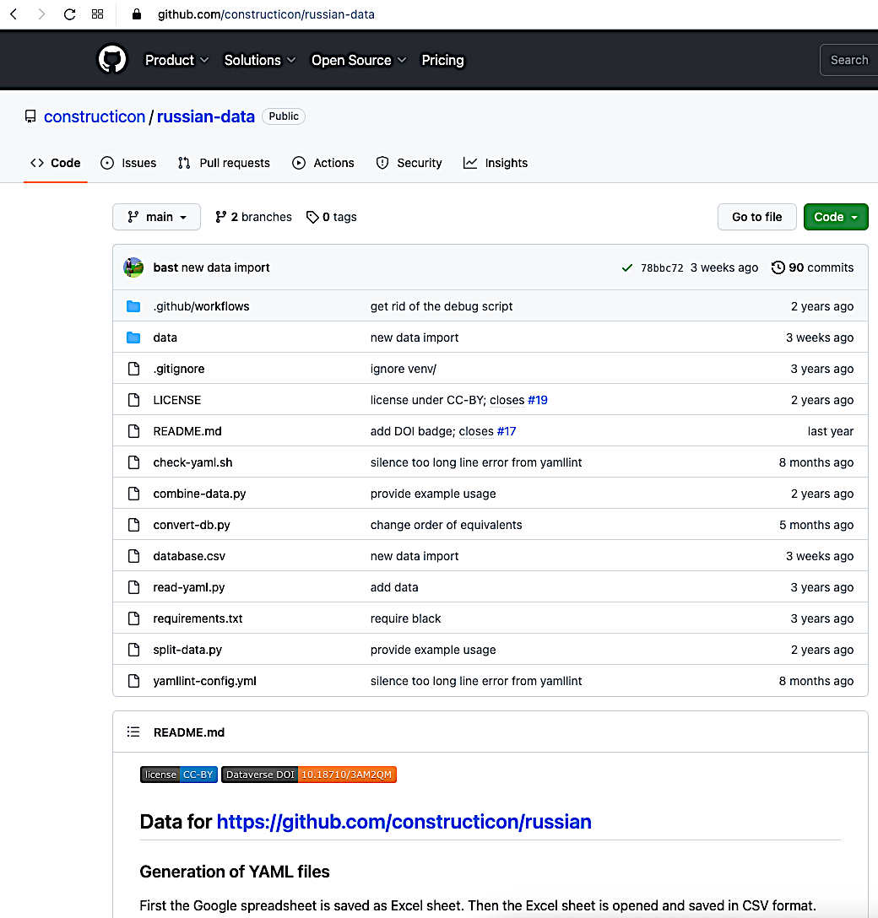
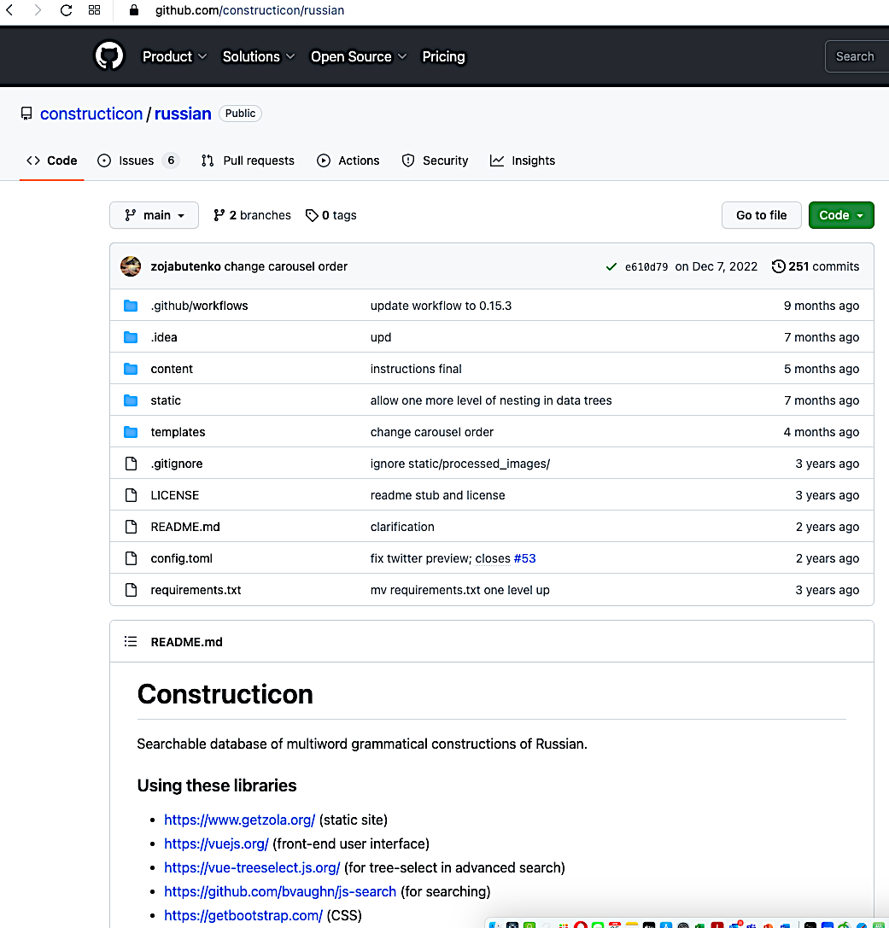
Code: portable for building comparable resources for other languages.
By design, the code that runs RusCon is separated from the data,
and this makes it possible to update the data without requiring updates of the code.
Notes:
As you see here, in Github we have two accounts, one for the code and one for the data. By design, the code that runs RusCon is separated from the data, and this makes it possible to update the data without requiring updates of the code.The code is open access and is portable for building comparable resources for other languages with minimal programming support.

Slide 20
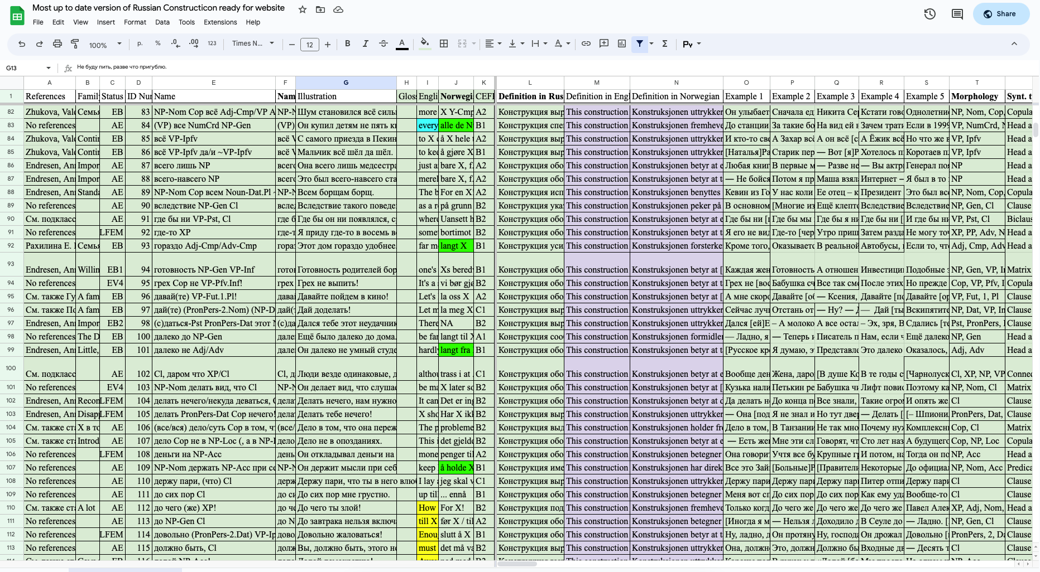
Our database is hosted in Google spreadsheet, which allows for simultaneous access and updating of the content by several team members at the same time.
Notes:
Here you can see how our database looks like. It is is hosted in Google spreadsheet, which allows for simultaneous access and updating of the content by several team members at the same time. This was especially helpful during the pandemic.

Slide 21
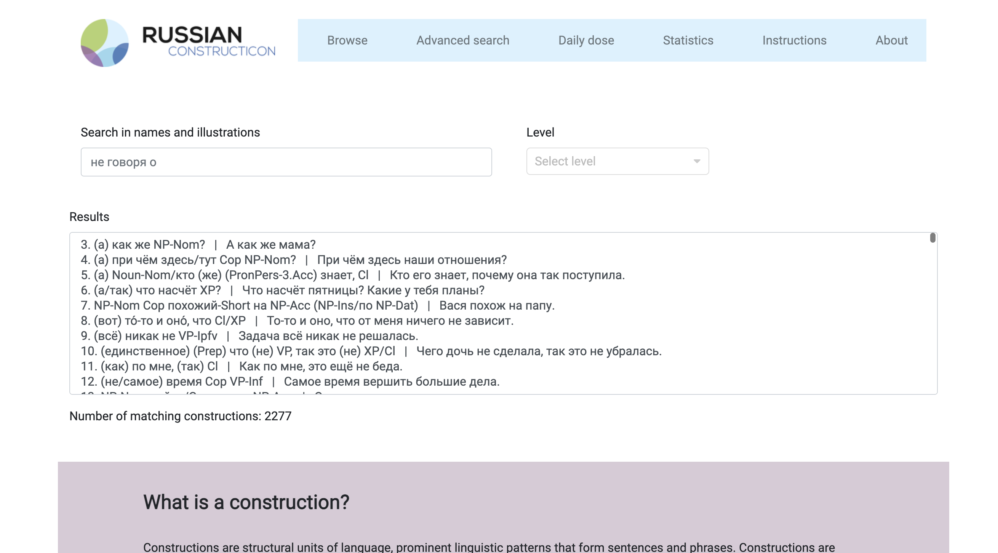

Select any construction, click on it and the description will appear at the bottom of the same page
'
Browse a list of over 4000 constructions
Notes:
This is the starting page of the Russian Cosntructicon, where the user can scroll through an entire list of collected constructions, select any construction from this list, click on it and see the description that appears at the bottom of the same page.

Slide 22
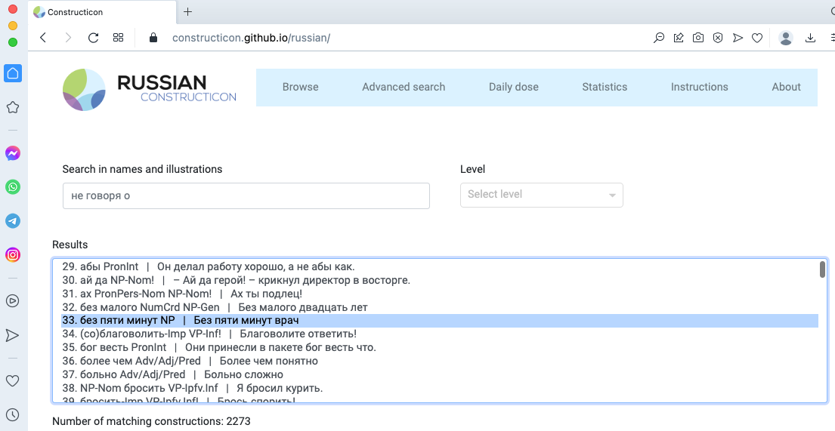
Each construction has an ID number, a name (a general morphosyntactic formula) and a short recognizable illustration.
ID-number
Name
Illustration
Notes:
Most constructions contain a fixed lexical part and an open slot (X) that can be filled with various words.
Boldfaced morphosyntacic representations constitute cognitively plausible generalizations that speakers arguably make over the specific exemplars they are exposed to in the process of language use.

Slide 23
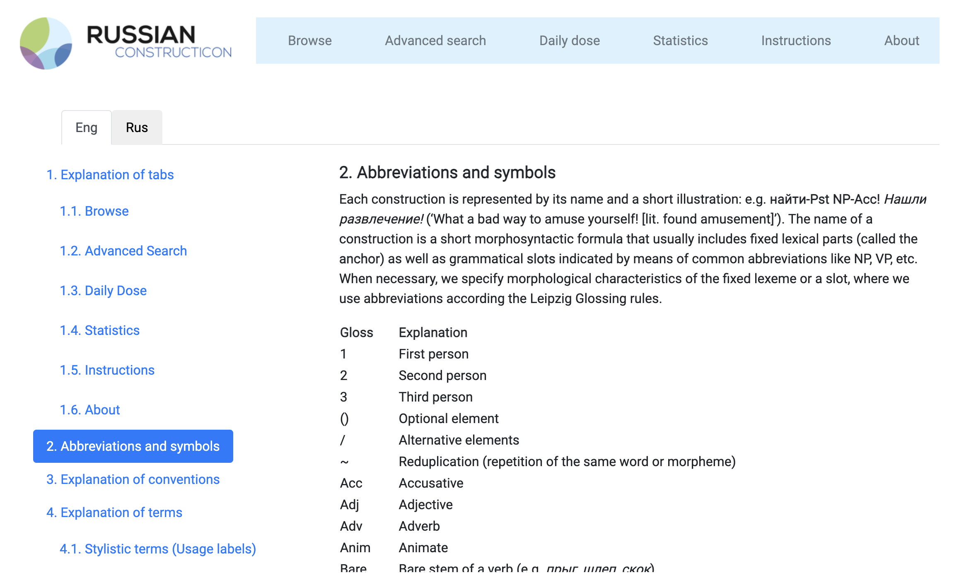
Notes:
We use abbreviations of morphological categories according to well-established conventions known as Leipzig Glossing Rules. We also use some standard syntactic notation like NP for noun phrase, VP for verb phrase, XP for any phrasal unit, etc.

Slide 24
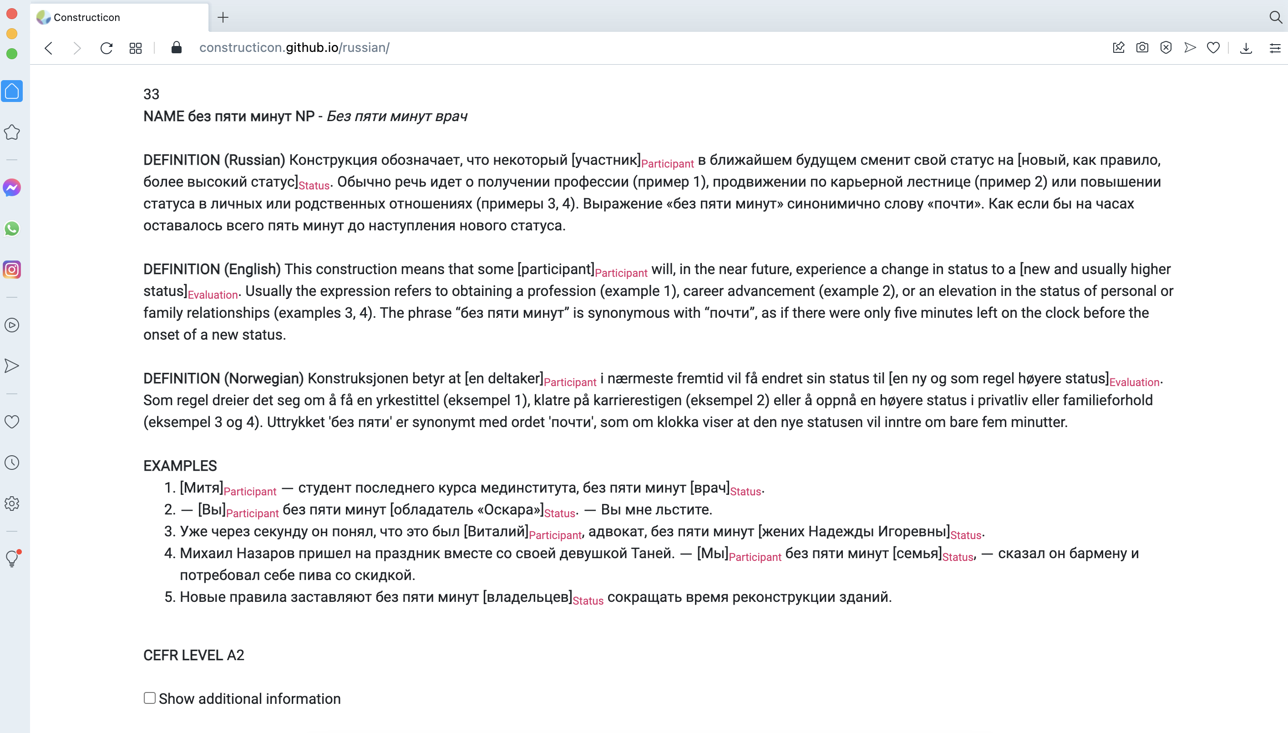
Partially schematic construction
literally: “without 5 minutes X”

Slide 25

English: five to + Numeral
literally: “without 5 minutes X”

Slide 26




English: five to + Numeral
literally: “without 5 minutes X”
bokstavelig: “uten 5 minutter X”
bez 5 minut vrač – 'a doctor to be'
bez 5 minut žena – 'a wife to be'
bez 5 minut papa – 'a dad to be'

Slide 27

CEFR – The Common European Framework of Reference for languages: A1-C2
Click here and see additional information.

Slide 28
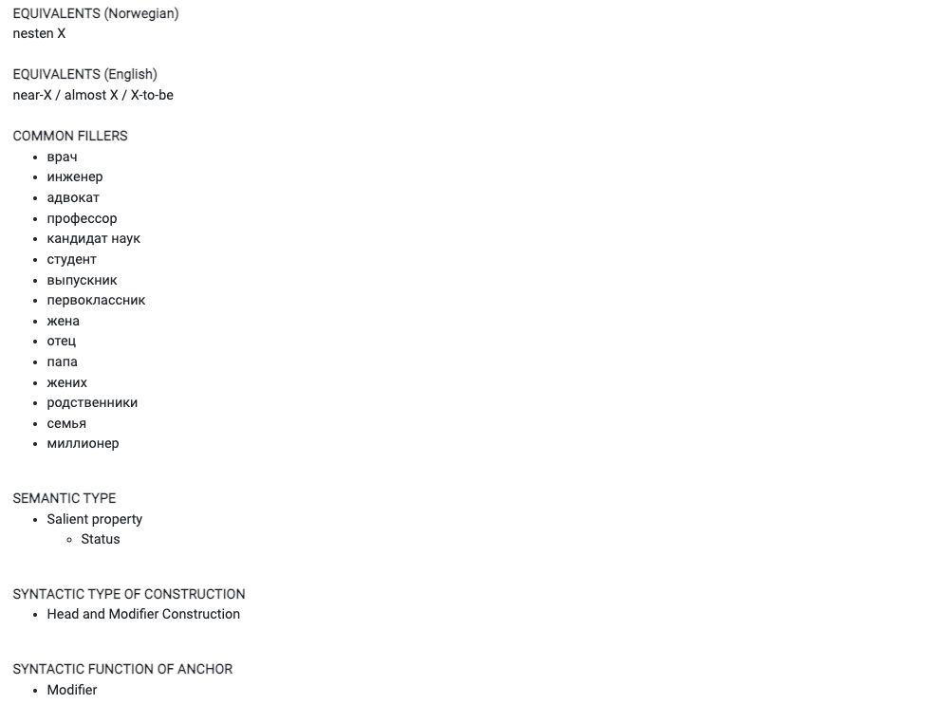
Additional information

Slide 29
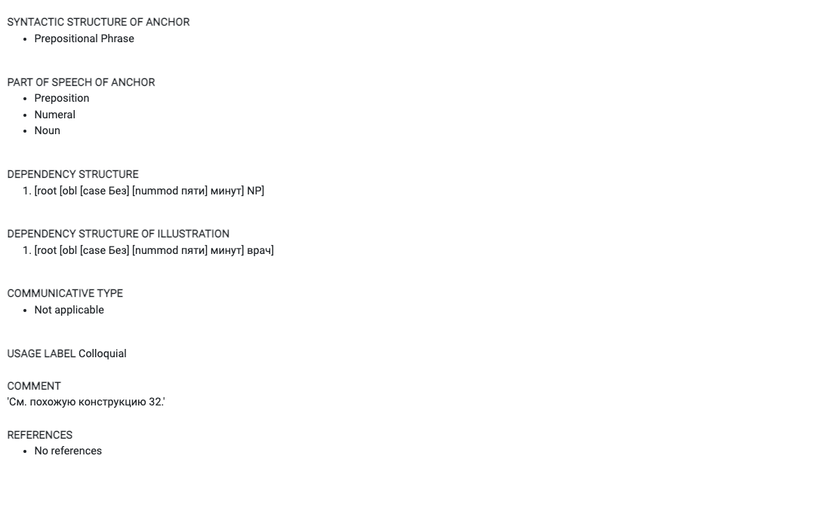
More additional information

Slide 30
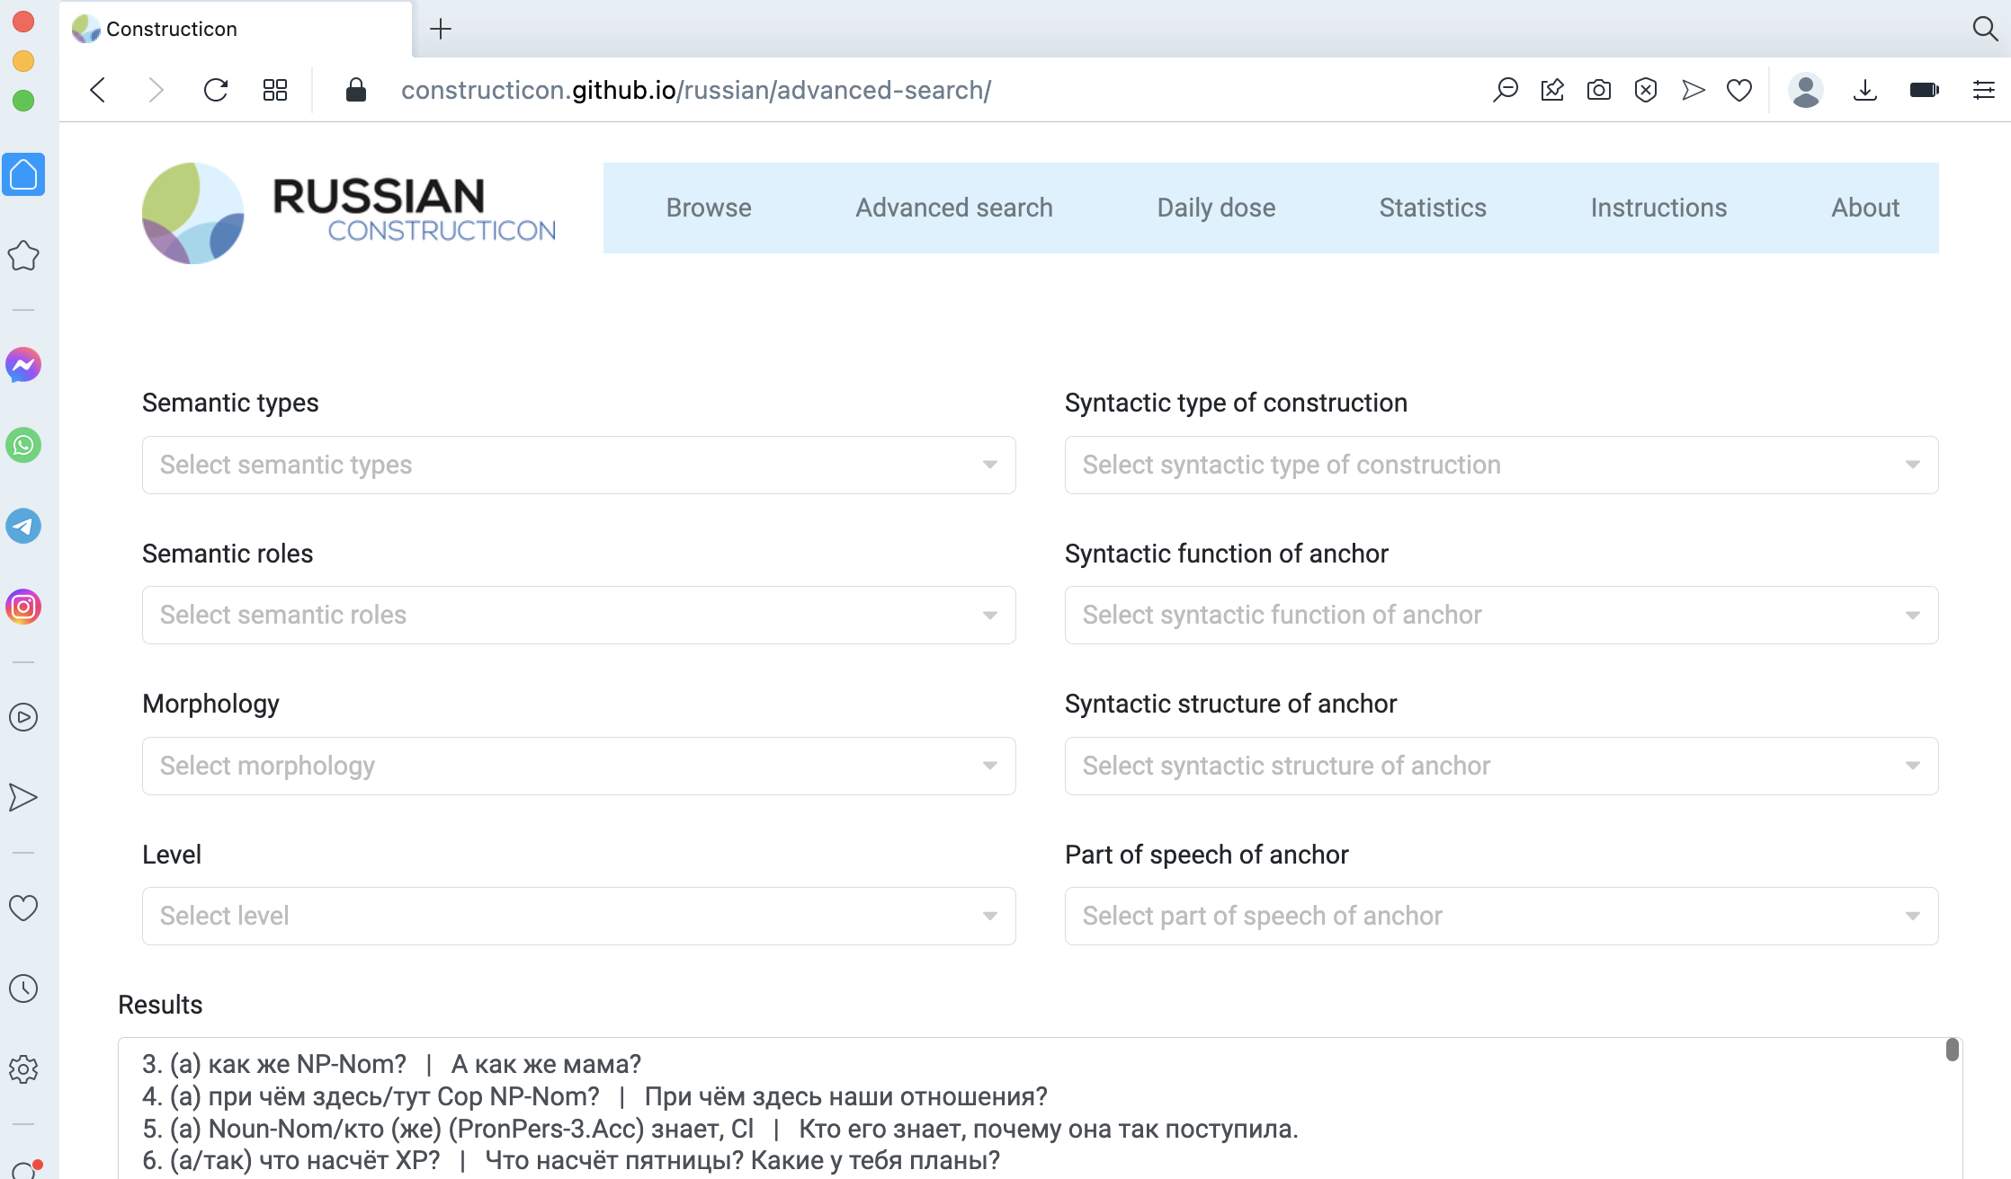

The user can combine several filters in the same search

Slide 31
If an anchor verb is used in a cxn only in a specific grammatical form, the cxn name indicates this form (or forms).
The anchor verb is only used here in two forms:
FUT.3SG or PST.SG.N
Negative assessment or attitude:
ID 294 s PronPers-Gen xvatit/xvatilo (NP-Gen)!
alternative elements in the lexical anchor
S | menja | xvat-it!
[from | I.gen | enough-fut.3sg]
‘‘I’m fed up [lit. from me enough]’

Slide 32
Apprehension expresses concern or warning regarding an “undesirable situation that the speaker deems possible and wants to avoid” (Baydina 2016). The speaker is afraid that this situation can take place (Apprehensive sub-type) (Dobrushina 2006)
Apprehensive cxn: ID 1099
((Ja) bojus’,) kak by ne VP-Pfv.Pst
() indicate optional elements
Ja | boj-u-s’, | kak | by | Miš-a | ne | opozda-l!
[l.NOM | fear-prs.1sg-refl | how | cond | Misha-nom | neg | be.late-pfv.pst.m]
Boj-u-s’, | kak | by | Miš-a | ne | opozda-l!
fear-prs.1sg-refl | how | cond | Misha-nom | neg | be.late-pfv.pst.m]
 |  | Kak | by | Miš-a | ne | opozda-l!
 |  | how | cond | Misha-nom | neg | be.late-pfv.pst.m]
‘If only Miša would not be late!’
Notes:
NP-Nom bojat'sja

Slide 33
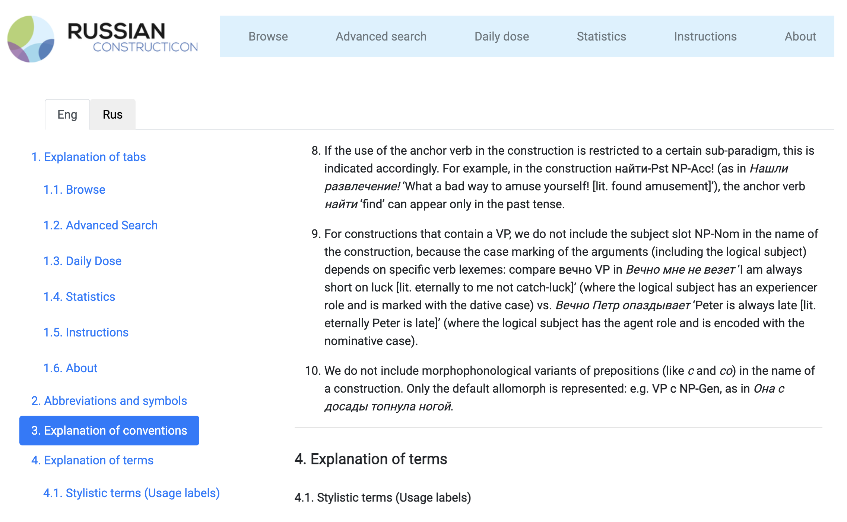

Slide 34
Našli razvlečenie! 'What a bad way to amuse yourself! [lit. Found amusement!]'
The anchor verb is only used here in the past tense
ID 193 najti-Pst NP-Acc!
literally 'found X'
(1) – Vy, značit, emu den’gi poslali? – Našli duru! Ni kopejki.
‘– So, in other words, you sent him money? – Do you take me for a fool?! [lit. Found fool!] Not a kopeck.’
The construction expresses the speaker's dissatisfaction with the interlocutor(s), who behave incorrectly (from the speaker's perspective) given the present situation.
(2) Provodil ja Sonju, vernulsja domoj, i mama govorit:
– Našel krasotku! Odna štukaturka.
‘I walked Sonja to her place and when I got home, mom says: – Some beauty you found yourself!! [lit. Found beauty!] She’s just plastered [with makeup].’
Encodes both Attitude of the speaker and Assessment of someone's behavior
(3) Xvatit smejat’sja v biblioteke. Našli mesto!
‘Enough laughing in the library. This is not the right place!! [lit. Found place!]’

Slide 35
Classification of constructions

Slide 36
Constructions are classified according to all of these parameters

Slide 37
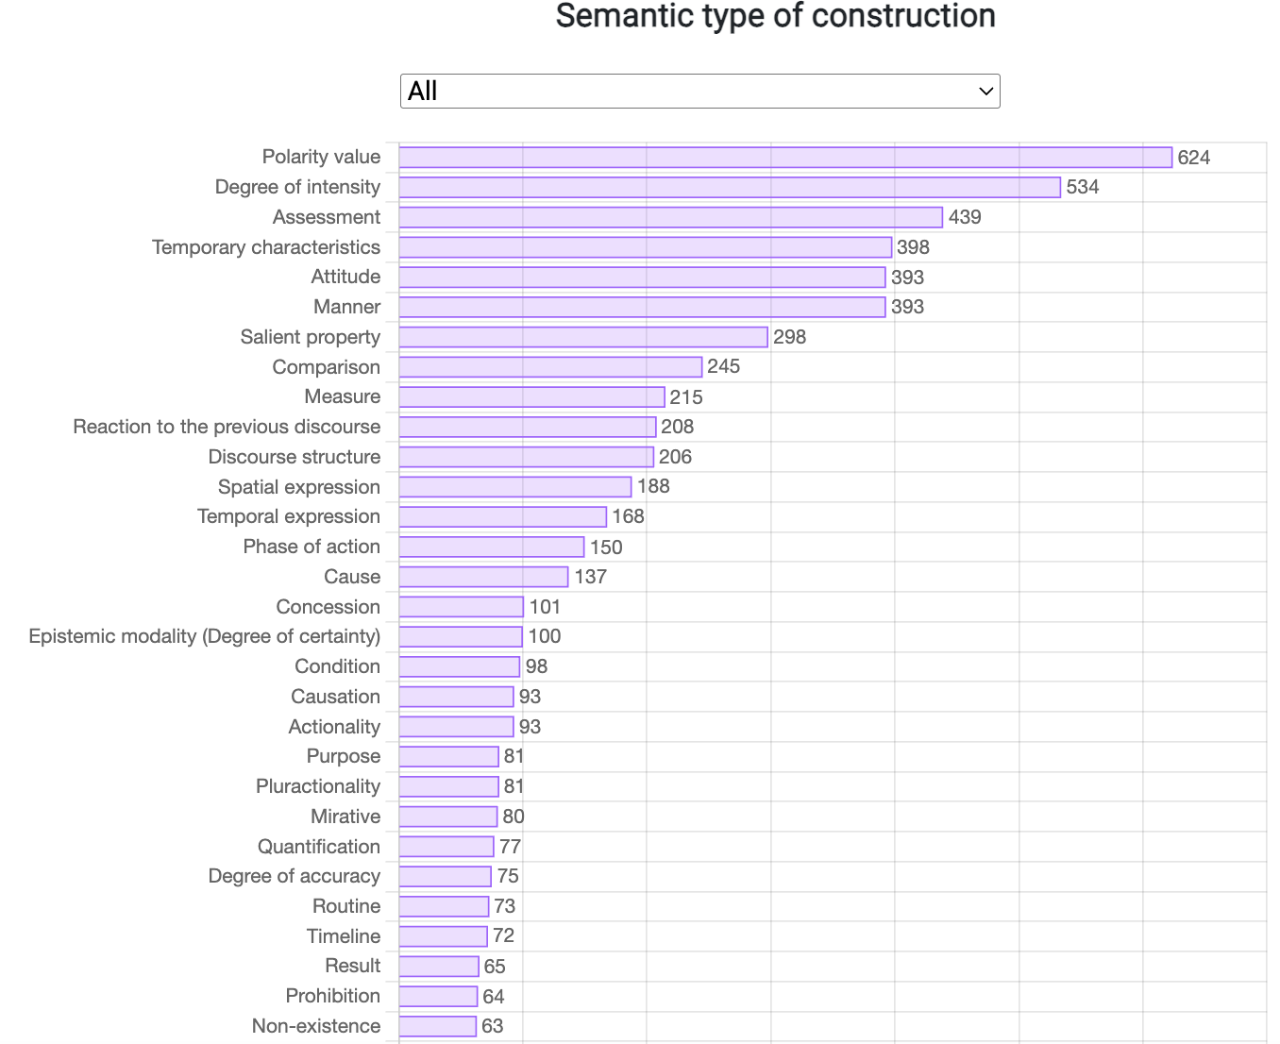

Slide 38
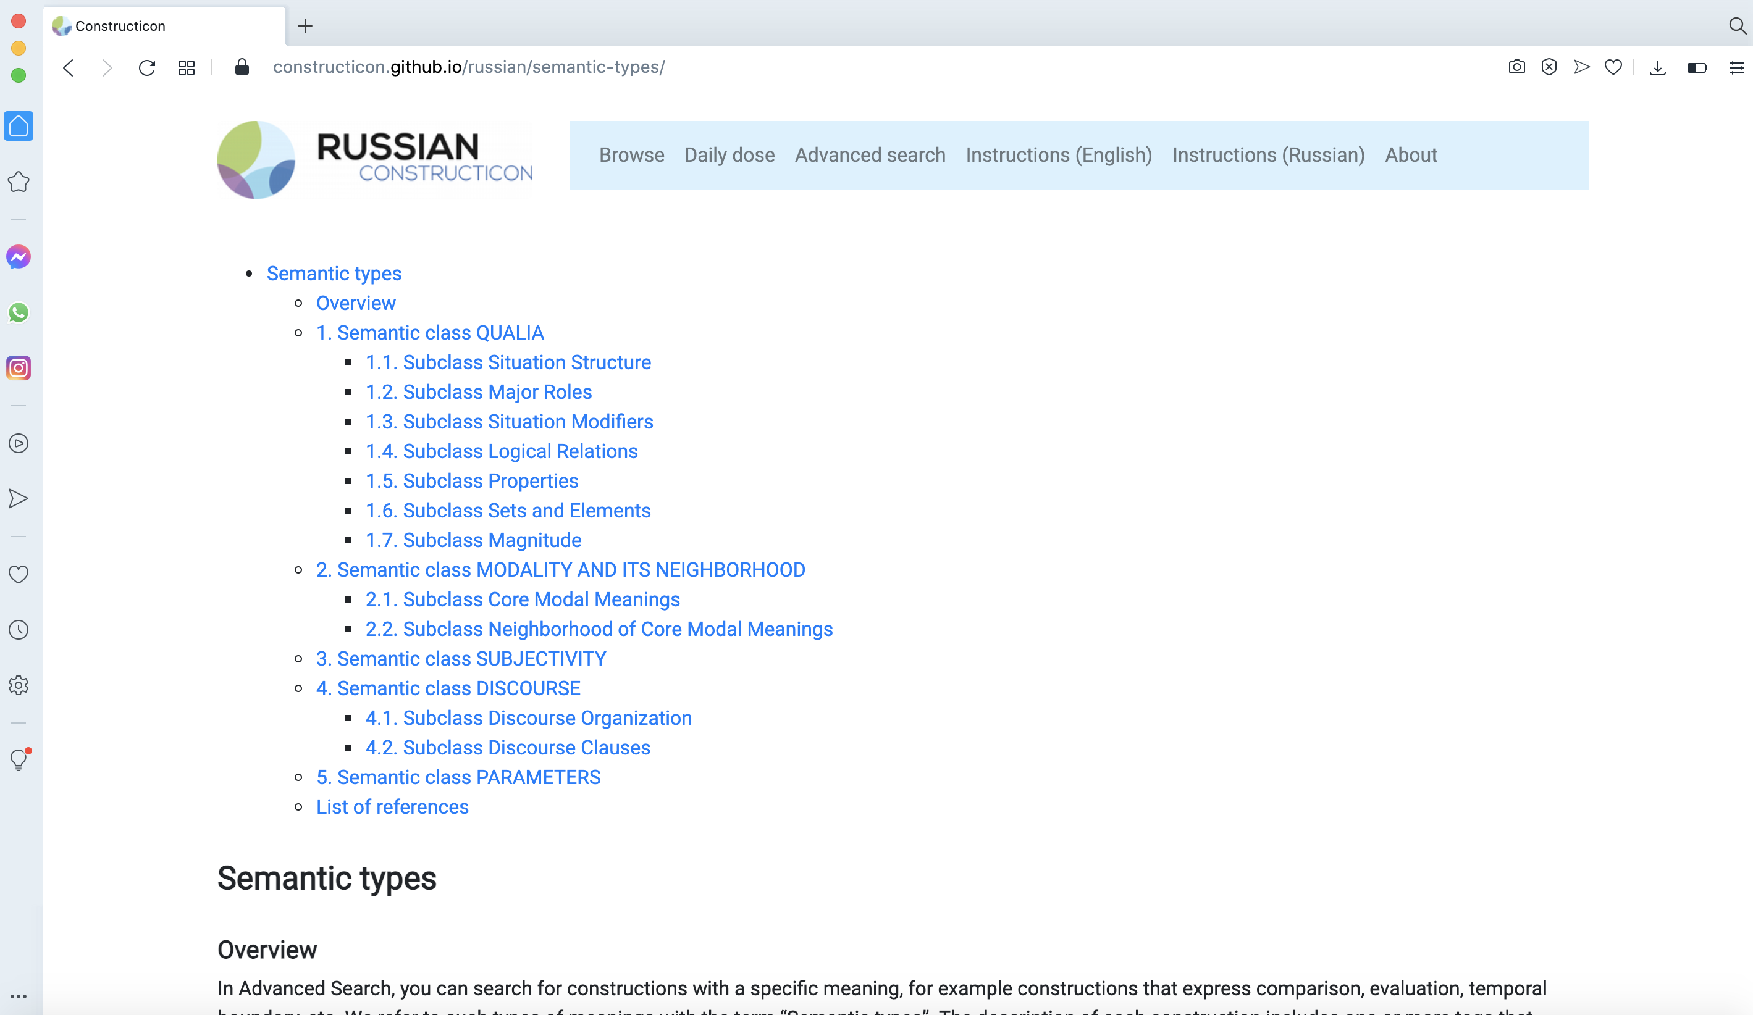
An overview and description of semantic types and subtypes of constructions,
grouped into numbered classes and subclasses (also available in Russian)
Janda, Laura A., Anna Endresen, Valentina Zhukova, Daria Mordashova, Ekaterina Rakhilina. 2023. From data to theory: an emergent semantic classification based on the large-scale Russian constructicon. Constructions and Frames 15(1), 1-58.

Slide 39
3 groupings emerge from the data
Family:
the smallest grouping of (usually 2-9) cxns that are nearly synonymous;
some members may also share similar syntactic structure and anchor words;
cxns in a family do not necessarily share all properties but various subsets of these properties (family resemblance)
focus on horizontal relationships between cxns, but can also include inheritance links
Cluster:
a group of families that displays a radial category structure,
with a core prototypical family of cxns and related families that are more or less peripheral and encode additional semantic nuances
Network:
a structured group of clusters sharing general semantics such as Prohibitive, Comparison, Assessment, etc.
Often contains a prototypical cluster and related clusters joined by semantic links or shared families

Slide 40
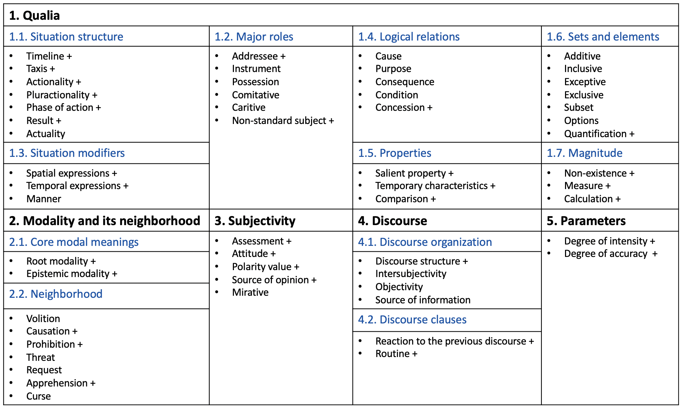
Semantic class “Qualia”
— constructions that describe the properties of the given objective physical world, external to the speaker

Slide 41
Semantic class “Modality and its neighborhood”

Slide 42
Semantic class “Subjectivity”
— constructions that encode the subjective evaluation of a situation, its elements or participants by the speaker.

Slide 43
Semantic class “Discourse”
— constructions that function at the discourse level:
structure the text
organize the communication
refer to a broader context than a single sentence

Slide 44
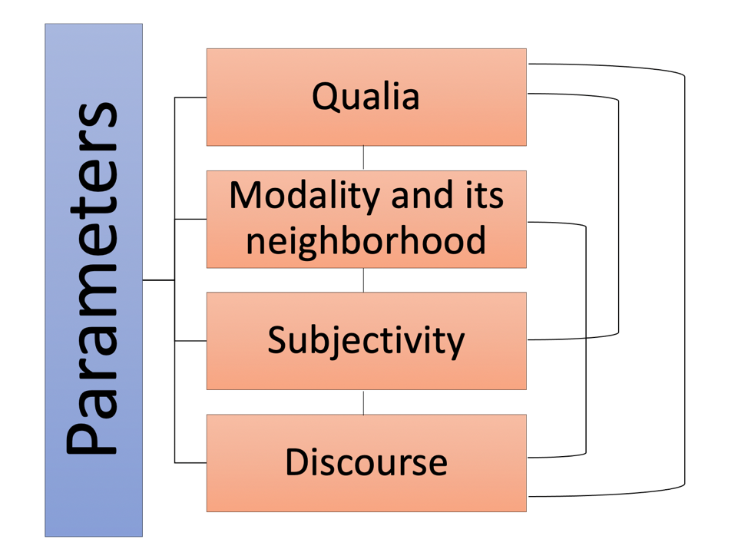
Semantic class “Parameters”
imply a scale that serves as a point of reference for a property or a situation characterized by a construction
can apply to other meanings

Slide 45
Multiply motivated constructions
Many constructions (over 40%) belong to more than one semantic type, and therefore carry two or more semantic tags and corresponding sub-tags.
Example:
Cl, i privet
'Cl, and hello'
On uže davno vzjal u menja ètu knigu, i privet! Uexal v otpusk.
'He borrowed my book a long time ago and suddenly disappeared [lit. and hello]. He left for vacation.'
1) type Non-Existence: subtype Disappear -> class Qualia;
2) type Mirative -> class Subjectivity
Semantic types and their classes often overlap at the level of individual constructions, and we can examine what kinds of overlaps are more frequent than others.

Slide 46
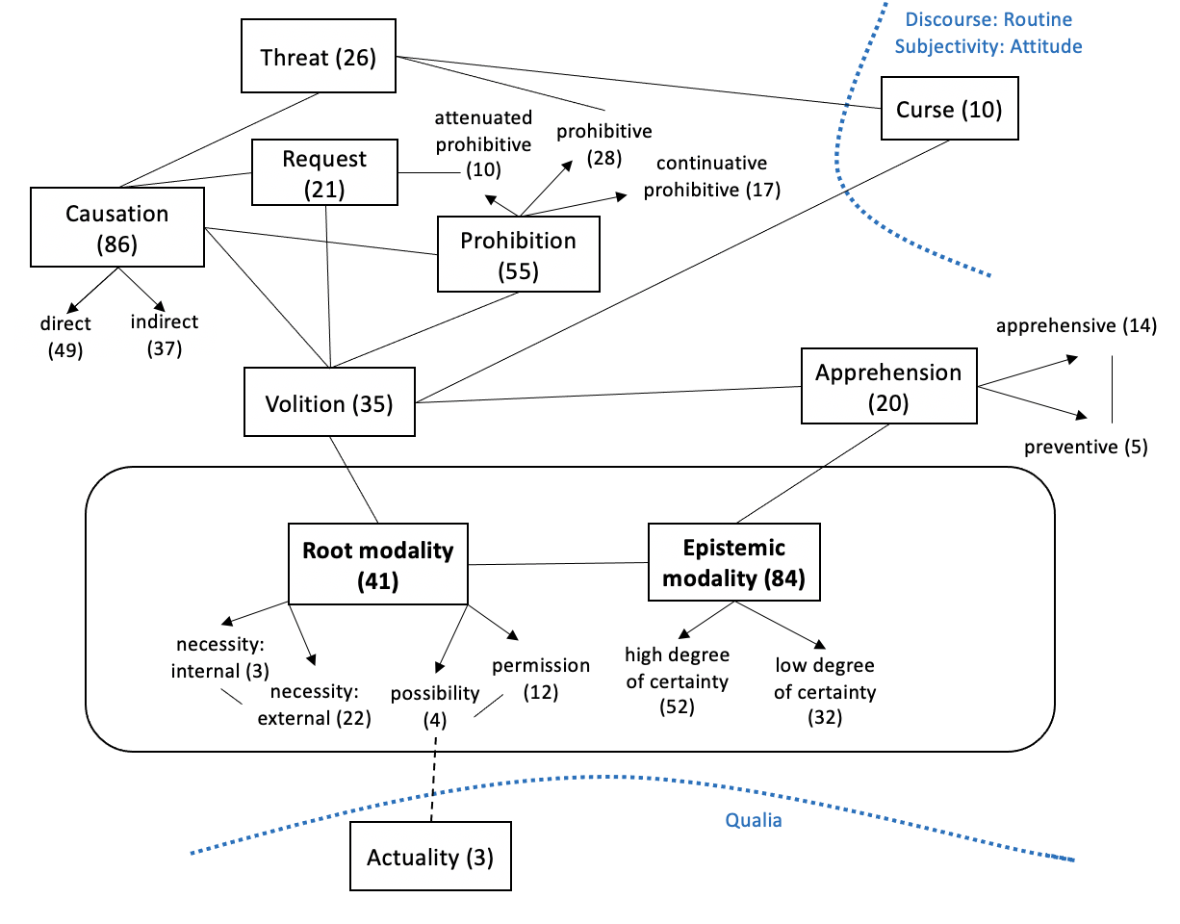
Class of constructions Modality and its neighborhood
301 constructions
Can be modelled as a radial category – central "core" modal meanings and their neighborhood
Includes 10 semantic types (visualized as boxes)
Arrows indicate subtypes of semantic types
Numbers in ( ) – type frequency of each type in terms of individual constructions
Solid lines – connections between types within this class
Dashed lines – overlaps with other classes (indicated by dotted blue lines)

Slide 47
Semantic type "Prohibition" = 1 network = 2 clusters = 12 families (a network of cxns that form 12 families grouped in 2 clusters)

Slide 48
Russian prohibitive constructions form 12 families visualized as boxes
1:2 (7 constructions)
General rules
Ne VP-Ipfv.Inf!
‘No X-ing!’
1:4 (7 constructions)
Prohibition of smallest portion
(Čtoby) nikakoj-Gen NP-Gen!
‘No X-es!’
1:5 (3 constructions)
Anticipation of resistance
PronPers-Nom ne VP-Fut!
‘You’re not going to do X!’
1:3 (10 constructions)
Milder tone
(NP-Dat) ne stoit VP-Ipfv.Inf
‘There’s no point in X-ing’
1:1 (5 constructions)
Prevention of intended activity
Ne smet’-Imp VP-Ipfv.Inf!
‘Don’t you dare X’
1:6 (3 constructions)
Prohibition against repeating
Čtob(y) PronPers bol’še ne VP-Pst!
‘No more X-ing!’
2:2 (7 constructions)
Quantitative, milder tone
xvatit (PronPers-2.Dat) VP-Ipfv.Inf!
‘Enough X-ing!’
2:1 (4 constructions)
Stop unwanted activity
brosit’-Imp VP-Ipfv.Inf!
‘Stop X-ing!’
2:5 (3 constructions)
Prohibition and Disapproval
NP-Dat li Cop VP-Inf?
‘Who are you to X?’
2:3 (2 constructions)
Delimitative
po-Verb-Pst i budet
‘You’ve done enough X-ing’
2:4 (3 constructions)
Stop temporarily
podoždat’-Imp VP-Ipfv.Inf
‘Stop X-ing for a while’
2:6 (3 constructions)
Prohibition and Threat
Ja PronPers-Dat VP-Fut!
‘You do X and you will regret it!’

Slide 49
Constructions in Cluster 1 ask a hearer to refrain from doing something, prohibit a future action. Cxns contain the marker of negation
1:2 (7 constructions)
General rules
Ne VP-Ipfv.Inf!
‘No X-ing!’
1:4 (7 constructions)
Prohibition of smallest portion
(Čtoby) nikakoj-Gen NP-Gen!
‘No X-es!’
1:5 (3 constructions)
Anticipation of resistance
PronPers-Nom ne VP-Fut!
‘You’re not going to do X!’
1:3 (10 constructions)
Milder tone
(NP-Dat) ne stoit VP-Ipfv.Inf
‘There’s no point in X-ing’
1:1 (5 constructions)
Prevention of intended activity
Ne smet’-Imp VP-Ipfv.Inf!
‘Don’t you dare X’
1:6 (3 constructions)
Prohibition against repeating
Čtob(y) PronPers bol’še ne VP-Pst!
‘No more X-ing!’
Constructions in Cluster 2 express prohibition of an on-going activity (termed continuative prohibition, cf. Rakhilina 2013, Khrakovski 1986),
Cxns lack the marker of negation
2:2 (7 constructions)
Quantitative, milder tone
xvatit (PronPers-2.Dat) VP-Ipfv.Inf!
‘Enough X-ing!’
2:1 (4 constructions)
Stop unwanted activity
brosit’-Imp VP-Ipfv.Inf!
‘Stop X-ing!’
2:5 (3 constructions)
Prohibition and Disapproval
NP-Dat li Cop VP-Inf?
‘Who are you to X?’
2:3 (2 constructions)
Delimitative
po-Verb-Pst i budet
‘You’ve done enough X-ing’
2:4 (3 constructions)
Stop temporarily
podoždat’-Imp VP-Ipfv.Inf
‘Stop X-ing for a while’
2:6 (3 constructions)
Prohibition and Threat
Ja PronPers-Dat VP-Fut!
‘You do X and you will regret it!’

Slide 50
Thick boxes indicate prototypes
1:2 (7 constructions)
General rules
Ne VP-Ipfv.Inf!
‘No X-ing!’
1:4 (7 constructions)
Prohibition of smallest portion
(Čtoby) nikakoj-Gen NP-Gen!
‘No X-es!’
1:5 (3 constructions)
Anticipation of resistance
PronPers-Nom ne VP-Fut!
‘You’re not going to do X!’
Cluster 1
1:3 (10 constructions)
Milder tone
(NP-Dat) ne stoit VP-Ipfv.Inf
‘There’s no point in X-ing’
1:1 (5 constructions)
Prevention of intended activity
Ne smet’-Imp VP-Ipfv.Inf!
‘Don’t you dare X’
1:6 (3 constructions)
Prohibition against repeating
Čtob(y) PronPers bol’še ne VP-Pst!
‘No more X-ing!’
2:2 (7 constructions)
Quantitative, milder tone
xvatit (PronPers-2.Dat) VP-Ipfv.Inf!
‘Enough X-ing!’
2:1 (4 constructions)
Stop unwanted activity
brosit’-Imp VP-Ipfv.Inf!
‘Stop X-ing!’
2:5 (3 constructions)
Prohibition and Disapproval
NP-Dat li Cop VP-Inf?
‘Who are you to X?’
Cluster 2
2:3 (2 constructions)
Delimitative
po-Verb-Pst i budet
‘You’ve done enough X-ing’
2:4 (3 constructions)
Stop temporarily
podoždat’-Imp VP-Ipfv.Inf
‘Stop X-ing for a while’
2:6 (3 constructions)
Prohibition and Threat
Ja PronPers-Dat VP-Fut!
‘You do X and you will regret it!’

Slide 51


Prototypical prohibition
1. The speaker prompts the interlocutor to not carry out an undesirable activity.
2. The interlocutor is an individual person or a specific group of people.
3. The speaker has more authority / life experience / higher status in the social hierarchy than the person to whom the prohibition is addressed (e.g. boss vs. subordinate, adult vs. child).
4. The prohibition is spoken in a strict commanding peremptory tone.

Slide 52
Lines with arrows show semantic transitions
1:2 (7 constructions)
General rules
Ne VP-Ipfv.Inf!
‘No X-ing!’
1:4 (7 constructions)
Prohibition of smallest portion
(Čtoby) nikakoj-Gen NP-Gen!
‘No X-es!’
1:5 (3 constructions)
Anticipation of resistance
PronPers-Nom ne VP-Fut!
‘You’re not going to do X!’
Cluster 1
generalization
intensification
opposition to repetition
1:1 (5 constructions)
Prevention of intended activity
Ne smet’-Imp VP-Ipfv.Inf!
‘Don’t you dare X’
opposition to resistance
1:6 (3 constructions)
Prohibition against repeating
Čtob(y) PronPers bol’še ne VP-Pst!
‘No more X-ing!’
1:3 (10 constructions)
Milder tone
(NP-Dat) ne stoit VP-Ipfv.Inf
‘There’s no point in X-ing’
attenuation
2:2 (7 constructions)
Quantitative, milder tone
xvatit (PronPers-2.Dat) VP-Ipfv.Inf!
‘Enough X-ing!’
2:1 (4 constructions)
Stop unwanted activity
brosit’-Imp VP-Ipfv.Inf!
‘Stop X-ing!’
aggression
2:5 (3 constructions)
Prohibition and Disapproval
NP-Dat li Cop VP-Inf?
‘Who are you to X?’
attenuation
Cluster 2
further attenuation
temporary
further aggression
2:3 (2 constructions)
Delimitative
po-Verb-Pst i budet
‘You’ve done enough X-ing’
2:4 (3 constructions)
Stop temporarily
podoždat’-Imp VP-Ipfv.Inf
‘Stop X-ing for a while’
2:6 (3 constructions)
Prohibition and Threat
Ja PronPers-Dat VP-Fut!
‘You do X and you will regret it!’

Slide 53
Clusters are connected through the semantic transition Continuative
1:2 (7 constructions)
General rules
Ne VP-Ipfv.Inf!
‘No X-ing!’
1:4 (7 constructions)
Prohibition of smallest portion
(Čtoby) nikakoj-Gen NP-Gen!
‘No X-es!’
1:5 (3 constructions)
Anticipation of resistance
PronPers-Nom ne VP-Fut!
‘You’re not going to do X!’
Cluster 1
generalization
intensification
opposition to repetition
1:1 (5 constructions)
Prevention of intended activity
Ne smet’-Imp VP-Ipfv.Inf!
‘Don’t you dare X’
opposition to resistance
1:6 (3 constructions)
Prohibition against repeating
Čtob(y) PronPers bol’še ne VP-Pst!
‘No more X-ing!’
1:3 (10 constructions)
Milder tone
(NP-Dat) ne stoit VP-Ipfv.Inf
‘There’s no point in X-ing’
attenuation
continuative
continuative
continuative
2:2 (7 constructions)
Quantitative, milder tone
xvatit (PronPers-2.Dat) VP-Ipfv.Inf!
‘Enough X-ing!’
2:1 (4 constructions)
Stop unwanted activity
brosit’-Imp VP-Ipfv.Inf!
‘Stop X-ing!’
aggression
2:5 (3 constructions)
Prohibition and Disapproval
NP-Dat li Cop VP-Inf?
‘Who are you to X?’
attenuation
Cluster 2
further attenuation
temporary
further aggression
2:3 (2 constructions)
Delimitative
po-Verb-Pst i budet
‘You’ve done enough X-ing’
2:4 (3 constructions)
Stop temporarily
podoždat’-Imp VP-Ipfv.Inf
‘Stop X-ing for a while’
2:6 (3 constructions)
Prohibition and Threat
Ja PronPers-Dat VP-Fut!
‘You do X and you will regret it!’
Notes:
updated version (see 1 additional family 2.5.)

Slide 54
Lines without arrows indicate syntactic/formal similarities
1:2 (7 constructions)
General rules
Ne VP-Ipfv.Inf!
‘No X-ing!’
1:4 (7 constructions)
Prohibition of smallest portion
(Čtoby) nikakoj-Gen NP-Gen!
‘No X-es!’
1:5 (3 constructions)
Anticipation of resistance
PronPers-Nom ne VP-Fut!
‘You’re not going to do X!’
Cluster 1
predicative
generalization
intensification
opposition to repetition
1:1 (5 constructions)
Prevention of intended activity
Ne smet’-Imp VP-Ipfv.Inf!
‘Don’t you dare X’
opposition to resistance
1:6 (3 constructions)
Prohibition against repeating
Čtob(y) PronPers bol’še ne VP-Pst!
‘No more X-ing!’
1:3 (10 constructions)
Milder tone
(NP-Dat) ne stoit VP-Ipfv.Inf
‘There’s no point in X-ing’
attenuation
predicative
continuative
imperative
continuative
continuative
2:2 (7 constructions)
Quantitative, milder tone
xvatit (PronPers-2.Dat) VP-Ipfv.Inf!
‘Enough X-ing!’
2:1 (4 constructions)
Stop unwanted activity
brosit’-Imp VP-Ipfv.Inf!
‘Stop X-ing!’
aggression
2:5 (3 constructions)
Prohibition and Disapproval
NP-Dat li Cop VP-Inf?
‘Who are you to X?’
attenuation
Cluster 2
further attenuation
imperative
temporary
further aggression
2:3 (2 constructions)
Delimitative
po-Verb-Pst i budet
‘You’ve done enough X-ing’
2:4 (3 constructions)
Stop temporarily
podoždat’-Imp VP-Ipfv.Inf
‘Stop X-ing for a while’
2:6 (3 constructions)
Prohibition and Threat
Ja PronPers-Dat VP-Fut!
‘You do X and you will regret it!’
po- prefix
Notes:
updated version (see 1 additional family 2.5.)

Slide 55
Dotted lines indicate weaker relationships
1:2 (7 constructions)
General rules
Ne VP-Ipfv.Inf!
‘No X-ing!’
1:4 (7 constructions)
Prohibition of smallest portion
(Čtoby) nikakoj-Gen NP-Gen!
‘No X-es!’
1:5 (3 constructions)
Anticipation of resistance
PronPers-Nom ne VP-Fut!
‘You’re not going to do X!’
Cluster 1
predicative
generalization
generalization
option
intensification
opposition to repetition
1:1 (5 constructions)
Prevention of intended activity
Ne smet’-Imp VP-Ipfv.Inf!
‘Don’t you dare X’
opposition to resistance
1:6 (3 constructions)
Prohibition against repeating
Čtob(y) PronPers bol’še ne VP-Pst!
‘No more X-ing!’
1:3 (10 constructions)
Milder tone
(NP-Dat) ne stoit VP-Ipfv.Inf
‘There’s no point in X-ing’
attenuation
predicative
continuative
imperative
continuative
continuative
2:2 (7 constructions)
Quantitative, milder tone
xvatit (PronPers-2.Dat) VP-Ipfv.Inf!
‘Enough X-ing!’
2:1 (4 constructions)
Stop unwanted activity
brosit’-Imp VP-Ipfv.Inf!
‘Stop X-ing!’
aggression
2:5 (3 constructions)
Prohibition and Disapproval
NP-Dat li Cop VP-Inf?
‘Who are you to X?’
attenuation
Cluster 2
further attenuation
imperative
temporary
further aggression
2:3 (2 constructions)
Delimitative
po-Verb-Pst i budet
‘You’ve done enough X-ing’
imperative
option
2:4 (3 constructions)
Stop temporarily
podoždat’-Imp VP-Ipfv.Inf
‘Stop X-ing for a while’
2:6 (3 constructions)
Prohibition and Threat
Ja PronPers-Dat VP-Fut!
‘You do X and you will regret it!’
po- prefix
imperative option,
po- prefix option
Notes:
updated version (see 1 additional family 2.5.)

Slide 56
Thick arrows indicate overlap with other networks of cxns formed through transitional cxns with multiple motivations
overlap with Intensity
1:2 (7 constructions)
General rules
Ne VP-Ipfv.Inf!
‘No X-ing!’
1:4 (7 constructions)
Prohibition of smallest portion
(Čtoby) nikakoj-Gen NP-Gen!
‘No X-es!’
1:5 (3 constructions)
Anticipation of resistance
PronPers-Nom ne VP-Fut!
‘You’re not going to do X!’
Cluster 1
predicative
generalization
generalization
option
intensification
opposition to repetition
1:1 (5 constructions)
Prevention of intended activity
Ne smet’-Imp VP-Ipfv.Inf!
‘Don’t you dare X’
opposition to resistance
1:6 (3 constructions)
Prohibition against repeating
Čtob(y) PronPers bol’še ne VP-Pst!
‘No more X-ing!’
overlap with Request
1:3 (10 constructions)
Milder tone
(NP-Dat) ne stoit VP-Ipfv.Inf
‘There’s no point in X-ing’
overlap with Warning
attenuation
predicative
continuative
imperative
continuative
continuative
2:2 (7 constructions)
Quantitative, milder tone
xvatit (PronPers-2.Dat) VP-Ipfv.Inf!
‘Enough X-ing!’
2:1 (4 constructions)
Stop unwanted activity
brosit’-Imp VP-Ipfv.Inf!
‘Stop X-ing!’
aggression
2:5 (3 constructions)
Prohibition and Disapproval
NP-Dat li Cop VP-Inf?
‘Who are you to X?’
overlap with Attitude
attenuation
Cluster 2
further attenuation
imperative
temporary
further aggression
2:3 (2 constructions)
Delimitative
po-Verb-Pst i budet
‘You’ve done enough X-ing’
imperative
option
overlap with Threat
2:4 (3 constructions)
Stop temporarily
podoždat’-Imp VP-Ipfv.Inf
‘Stop X-ing for a while’
2:6 (3 constructions)
Prohibition and Threat
Ja PronPers-Dat VP-Fut!
‘You do X and you will regret it!’
po- prefix
imperative option,
po- prefix option
Notes:
updated version (see 1 additional family 2.5.)

Slide 57
Network of Russian prohibitive constructions
Legend:
overlap with Intensity
semantic transitions
syntactic/formal similarities
1:2 (7 constructions)
General rules
Ne VP-Ipfv.Inf!
‘No X-ing!’
weaker relationships
1:4 (7 constructions)
Prohibition of smallest portion
(Čtoby) nikakoj-Gen NP-Gen!
‘No X-es!’
1:5 (3 constructions)
Anticipation of resistance
PronPers-Nom ne VP-Fut!
‘You’re not going to do X!’
overlap with other networks of cxns
Cluster 1
predicative
generalization
generalization
option
intensification
opposition to repetition
1:1 (5 constructions)
Prevention of intended activity
Ne smet’-Imp VP-Ipfv.Inf!
‘Don’t you dare X’
opposition to resistance
1:6 (3 constructions)
Prohibition against repeating
Čtob(y) PronPers bol’še ne VP-Pst!
‘No more X-ing!’
overlap with Request
1:3 (10 constructions)
Milder tone
(NP-Dat) ne stoit VP-Ipfv.Inf
‘There’s no point in X-ing’
overlap with Warning
attenuation
predicative
continuative
imperative
continuative
continuative
2:2 (7 constructions)
Quantitative, milder tone
xvatit (PronPers-2.Dat) VP-Ipfv.Inf!
‘Enough X-ing!’
2:1 (4 constructions)
Stop unwanted activity
brosit’-Imp VP-Ipfv.Inf!
‘Stop X-ing!’
aggression
2:5 (3 constructions)
Prohibition and Disapproval
NP-Dat li Cop VP-Inf?
‘Who are you to X?’
overlap with Attitude
attenuation
Cluster 2
further attenuation
imperative
temporary
further aggression
2:3 (2 constructions)
Delimitative
po-Verb-Pst i budet
‘You’ve done enough X-ing’
imperative
option
overlap with Threat
2:4 (3 constructions)
Stop temporarily
podoždat’-Imp VP-Ipfv.Inf
‘Stop X-ing for a while’
2:6 (3 constructions)
Prohibition and Threat
Ja PronPers-Dat VP-Fut!
‘You do X and you will regret it!’
po- prefix
imperative option,
po- prefix option
Notes:
We propose to analyze constructions in terms meaningful groupings: family – cluster – network

Slide 58
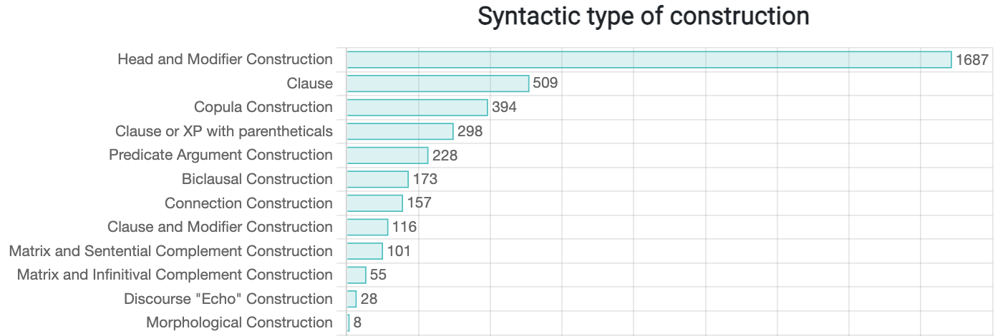

Slide 59
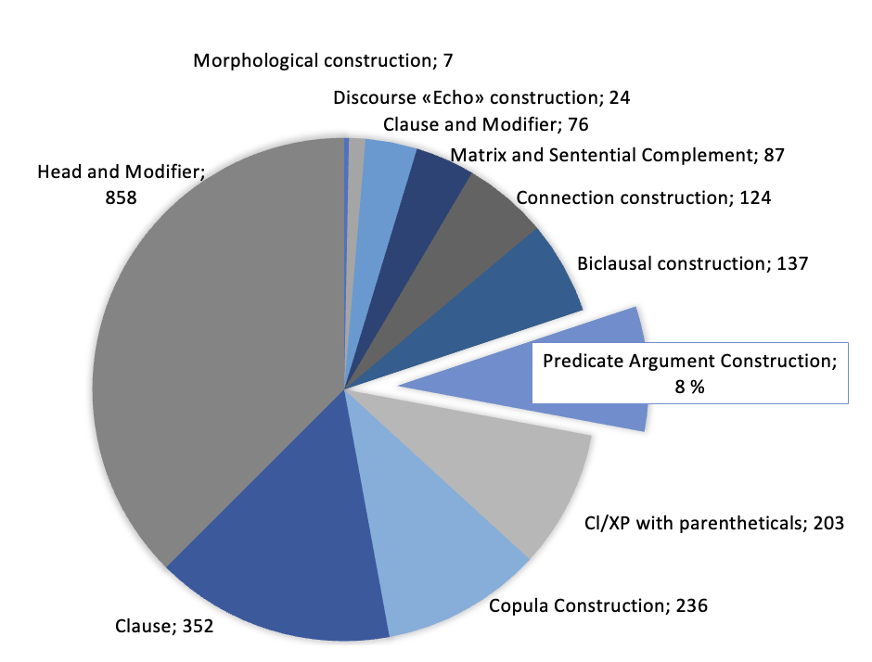
A variety of syntactic patterns in RusCon
ID 33. bez pjati minut NP – lit. ‘without five minutes X’
Predicate Argument Constructions (that are most important for other existing constructicon resources) yield only 8% of the entire database.
e.g.
ID 465
NP-Acc zvat'-Inf NP-Ins/NP-Nom - Mal’čika zvat’ Juroj.
‘The boy’s name is Jura’
Notes:
Russian lacks a fully developed FrameNet resource

Slide 60
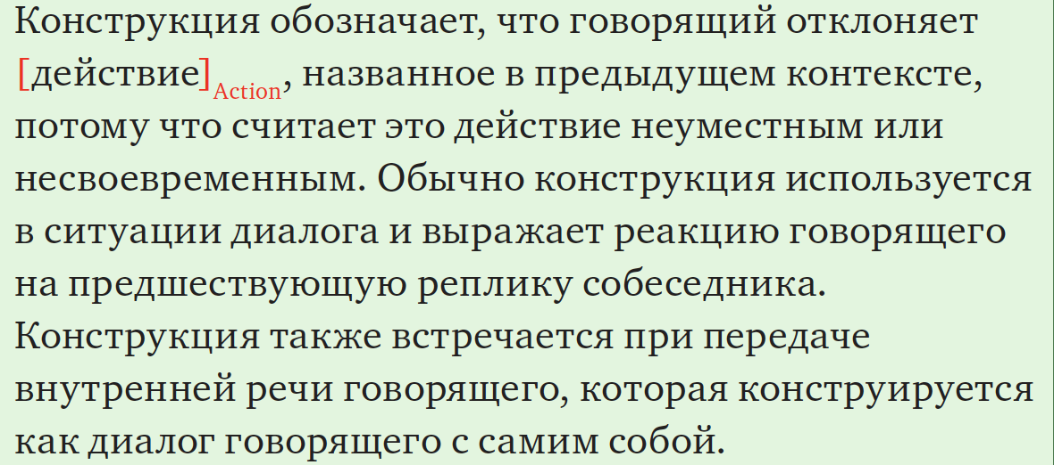
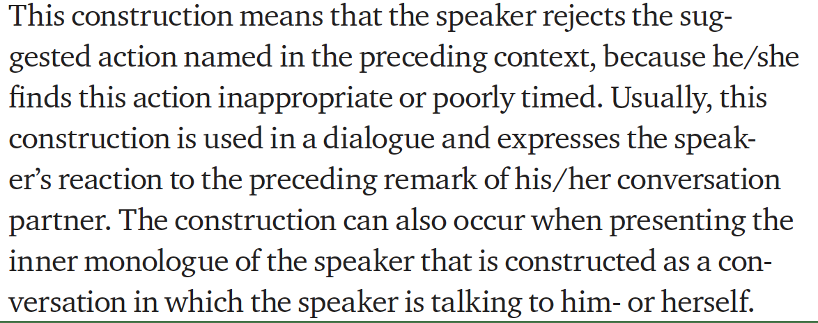
Larger discourse units = often constructions beyond a single clause
“Echo” constructions: they pick up something in the previous discourse, repeat the element (often quote it in the same morphosyntactic form) and add a comment
24 Discourse “echo” constructions in the Russian Constructicon
e.g.: ID163
kakoj/kakoe tam VP-Pst!
– Ty poel? – Kakoj tam poel! U menja ne bylo vremeni...
you eat-Pst? what there eat-Pst by me-Gen not be-Pst time-Gen
‘– Did you manage to eat? – How could I even do that! I did not have time...’

Slide 61
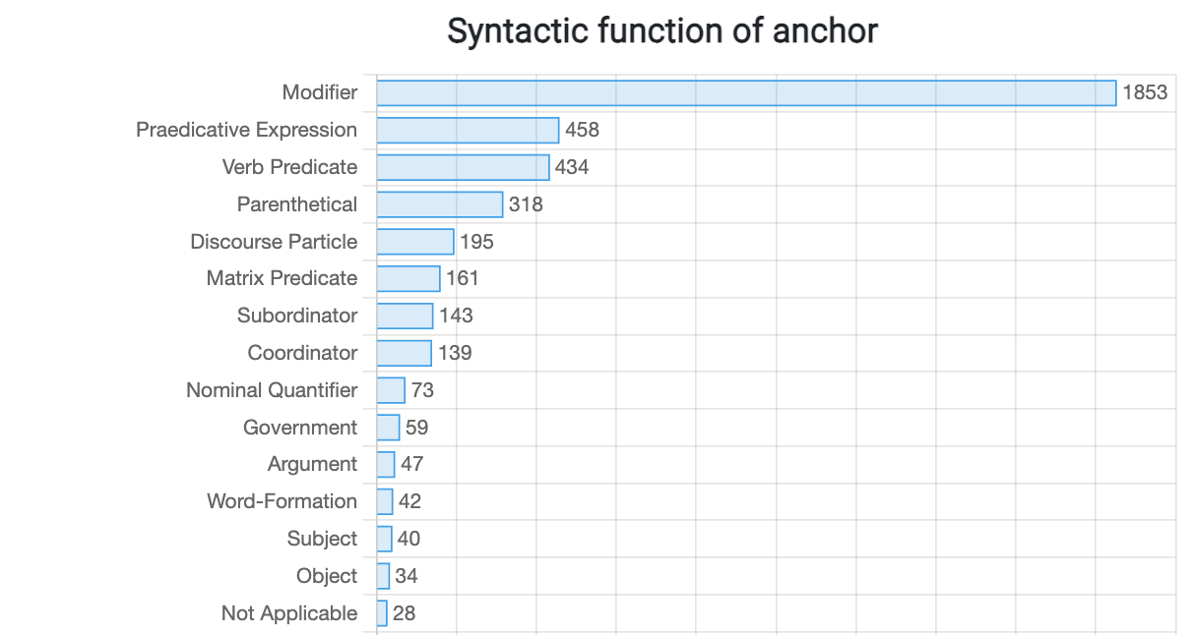

Slide 62
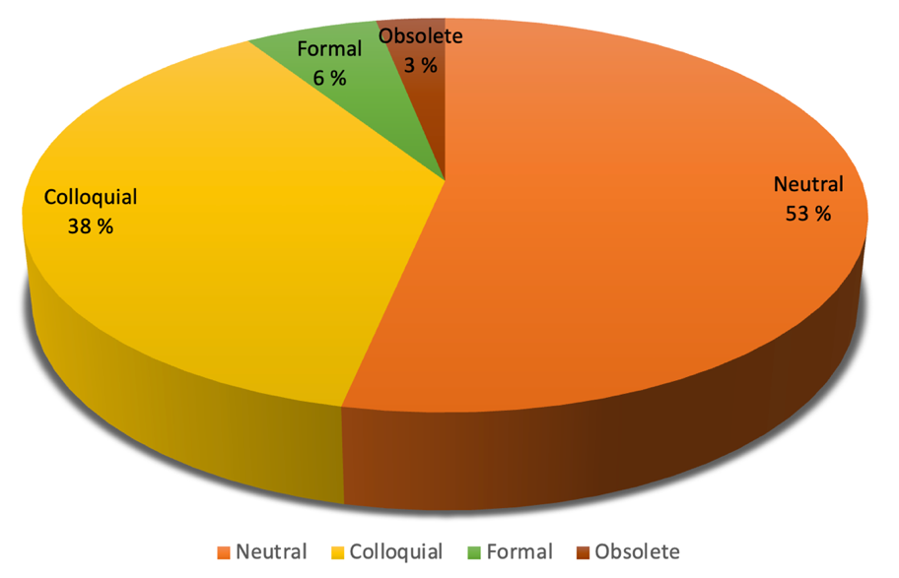
Distribution og registers in RusCon

Slide 63
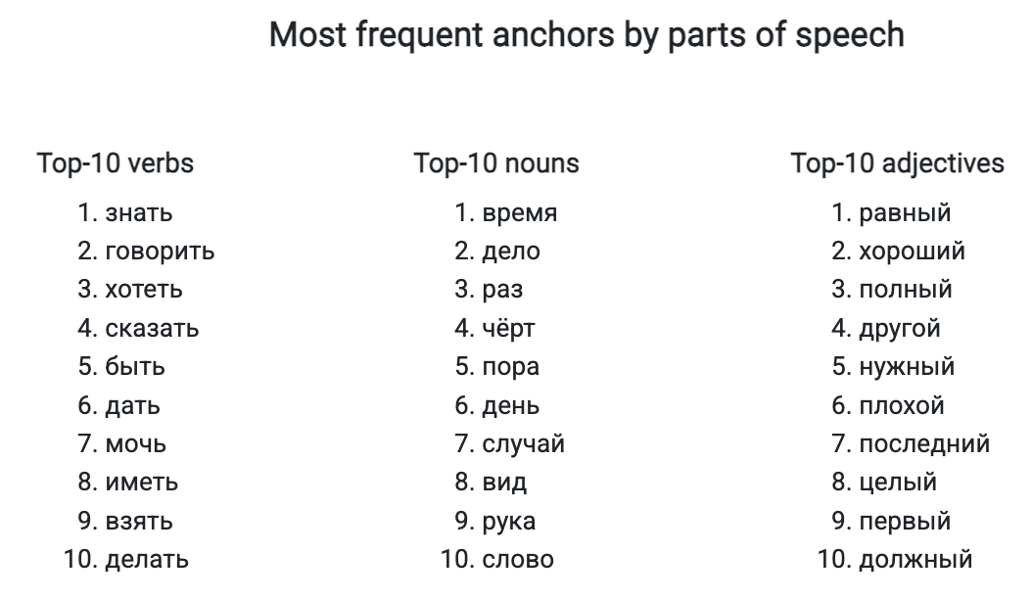

Slide 64


Can ChatGPT/ChatUiT ...?
identify a correct definition?
write a definition?
assign semantic tags according to RusCon semantic annotation?
identify register (informal, formal)?
assign language proficiency level (CEFR)?
suggest common fillers?
find corresponding constructions in other languages (RUS-NOR-ENG)?
identify constructions in example sentences?
generate example sentences?

Slide 65
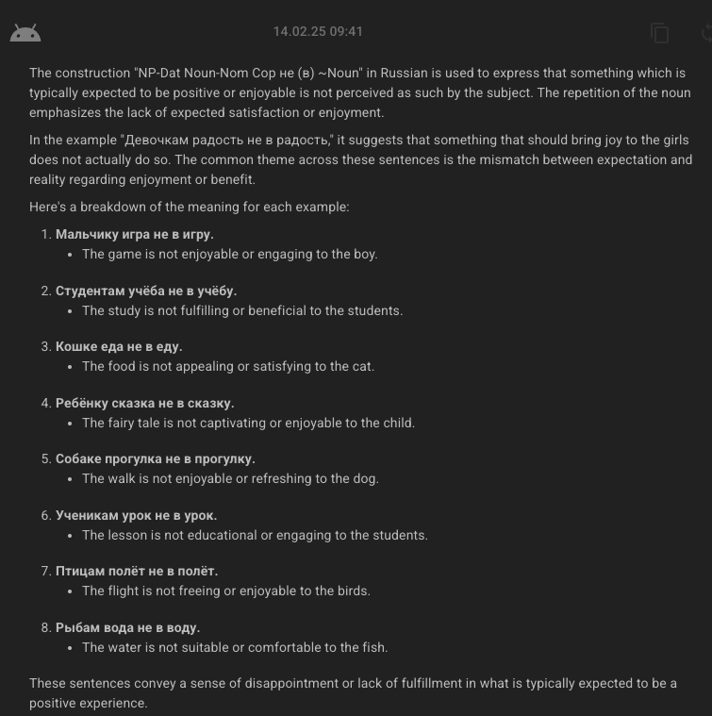
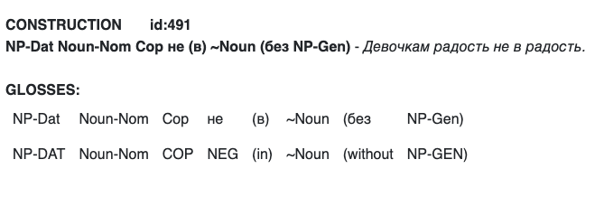

ChatUiT will try to generate example sentences, but...
BAD NEWS: the generated examples match the structural pattern but are very unnatural.
GOOD NEWS: Unnatural examples can trigger additional analysis of restrictions on fillers and contexts that we (might) have overlooked.
Can you provide several examples of this construction?
Mistakes made by ChatUiT are similar to those of L2-learners of Russian

Slide 66
Use of Russian Constructicon

Slide 67
Constructicon as a resource for research
Janda, L. A., V. Zhukova, A. Endresen. 2024. Typology of reduplication in Russian: Constructions within and beyond a single clause. In M. Kopotev and K. Kwon (Eds.), Constructions with lexical repetitions in East Slavic languages (Volume 384 in the series Trends in Linguistics. Studies and Monographs [TiLSM]), 71–96. 2024. De Gruyter Mouton. https://doi.org/10.1515/9783111165806-003
The constructicon makes it possible to:
research a phenomenon in wholistic manner
show how a phenomenon connects with the system of a language
show how common a phenomenon is in a language

Slide 68

How to get students to engage with the constructicon?

Slide 69
Our choice: discourse constructions
ID | Construction | Illustration | GLOSS
1087 | inymi/drugimi slovami, XP/Cl | Naš korrespondent vyexal v aèroport, čtoby vzjatʹ intervʹju. Drugimi slovami, zadatʹ neskolʹko voprosov. | IN OTHER WORDS, …
1840 | k primeru, Cl/XP | Vot, k primeru, mne nravitsja Merilin Monro. | FOR EXAMPLE, …
1872 | (i) kstati (govorja), Cl | I kstati, on prišël bez podarka. | BY THE WAY, …
6 | (a/tak) čto nasčët XP? | Čto nasčët pjatnicy? Kakie u tebja plany? | WHAT ABOUT …?
2273 | v-NumOrd-yx, XP/Cl | Vo-pervyx, ja by xotel poblagodaritʹ svoego trenera. | FIRST OF ALL, …
1839 | takim obrazom, Cl | Takim obrazom, naša komanda za god dobilasʹ važnyx rezulʹtatov. | THEREFORE, …
11 | (kak) po mne, (tak) Cl | Kak po mne, èto eščë ne beda. | AS FOR ME, …
2281 | Cl, ne pravda li? | Interesnyj xudožnik, ne pravda li? | …, ISN’T IT?
1133 | mjagko govorja, Cl | On, mjagko govorja, ne podarok. | TO PUT IT MILDLY, …
Clarify your point
Give an example
Add information
Introduce a topic
Structure your argument
Draw a conclusion
Express your opinion
Ask someone for their opinion
Hedge
Notes:
We decided to start the implementation from discourse constructions.
To give you a flavor of what kind of constructions we included, here are some examples. Mostly parenthetical expressions
simple to use because most of them are Clause + Modifier constructions (конструкция с модификатором который относится ко всей клаузе), meaning that the fixed lexical element of the construction is an adverbial that modifies an entire clause. The fixed lexical elements in these constructions are mostly parenthetical (the Russian term вводные слова) and do not disturb the overall syntactic structure of a sentence they are inserted in. This makes these constructions relatively easy to learn even at early stages of L2 acquisition. At the same time, these constructions are widely used and can express a variety of pragmatic and semantic nuances. Moreover, they can function to scaffold text, by providing milestones or control points in text production.

Slide 70
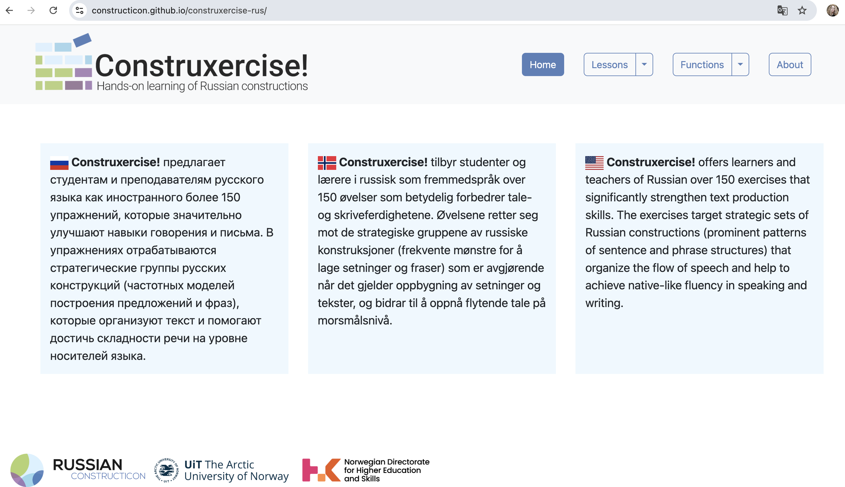
The exercises are groupped by lessons and by functions.
The interface is in Russian, but we provide translations of the content
in English and Norwegian.

Slide 71
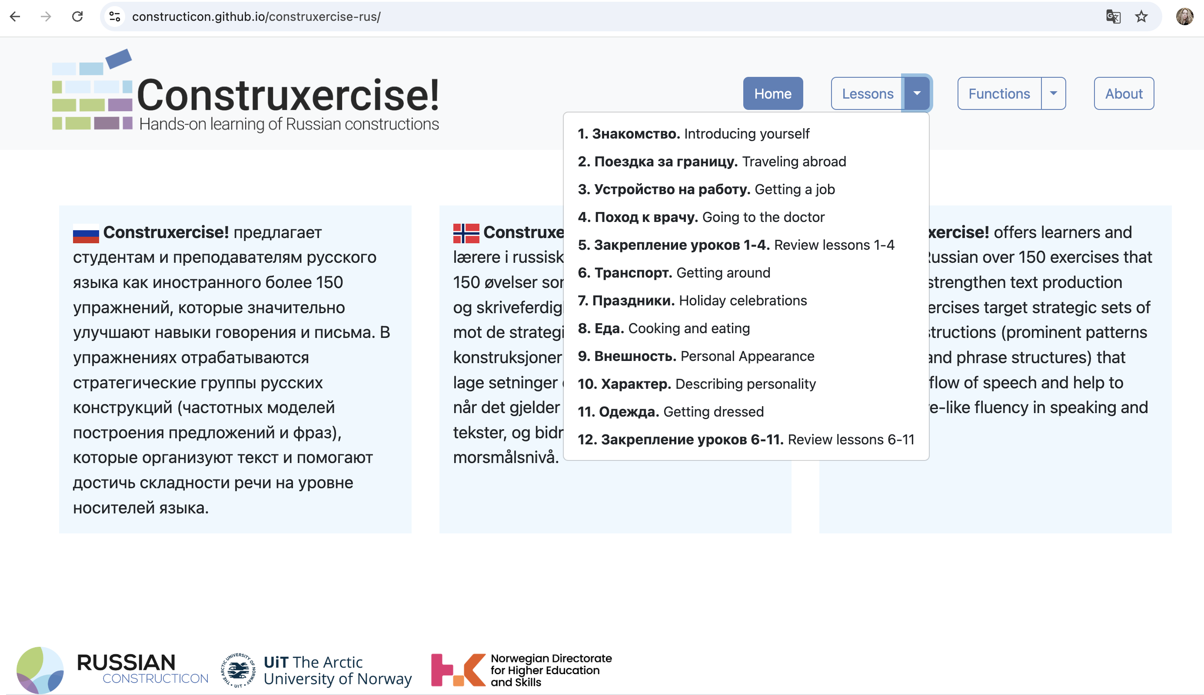
The exercises cover major conversational topics commonly used in teaching Russian as a foreign language.

Slide 72
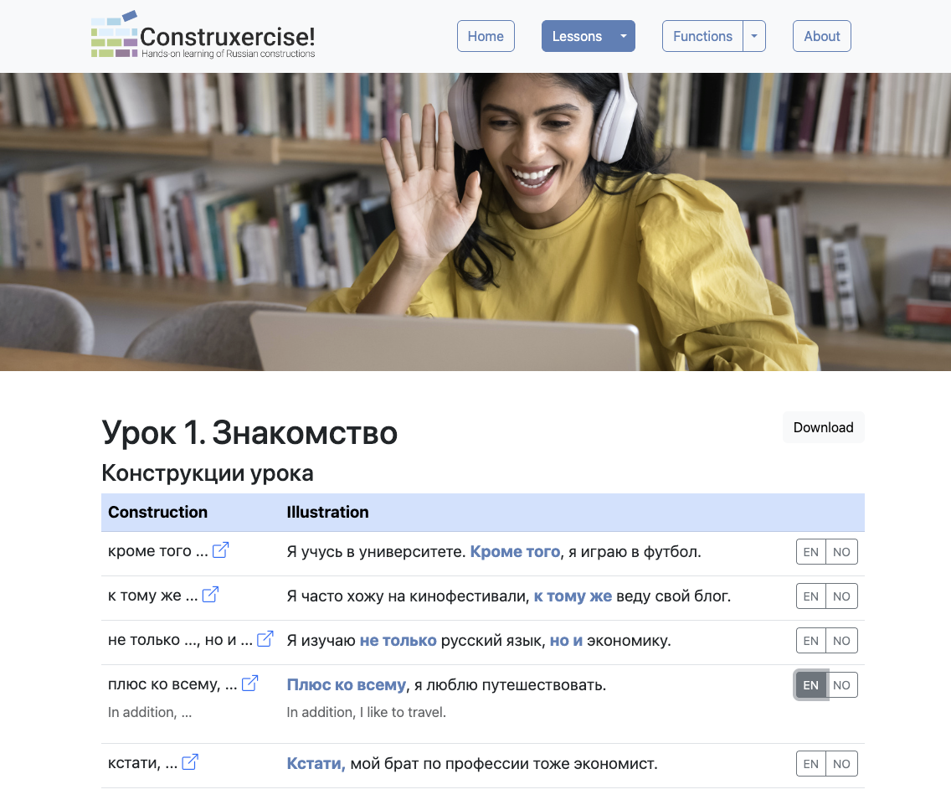
2025: created version 2.0
(using feedback from 2022-2024)
Simplified,
student-friendly representations of constructions
New illustrations that match the topic of the lesson
Individual links to descriptions in RusCon
Option to view the translation to English and Norwegian
Corresponding cxns in Eng and Norw
Notes:
This semester, we focused on updating the content. The new version of the resource includes:
Simplified, student-friendly representations of constructions.
Individual links to construction descriptions in the Russian Constructicon.
Corresponding counterparts provided in English and Norwegian, along with translations of illustrative sentences.
Added voiceover files, allowing the microtexts to be used as listening exercises.
A feature on the website where you can check your answers and view additional translations of the tasks.
We also plan to record short videos for each lesson and use them for flipped classroom sessions.

Slide 73
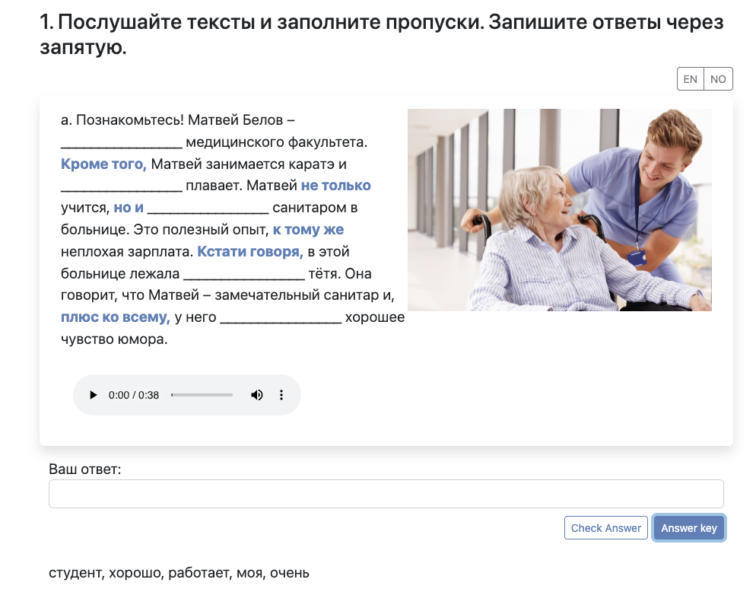
Added voiceover, allowing the microtexts to be used as listening exercises.
Improved functionality: check your answers and
view the answer key

Slide 74
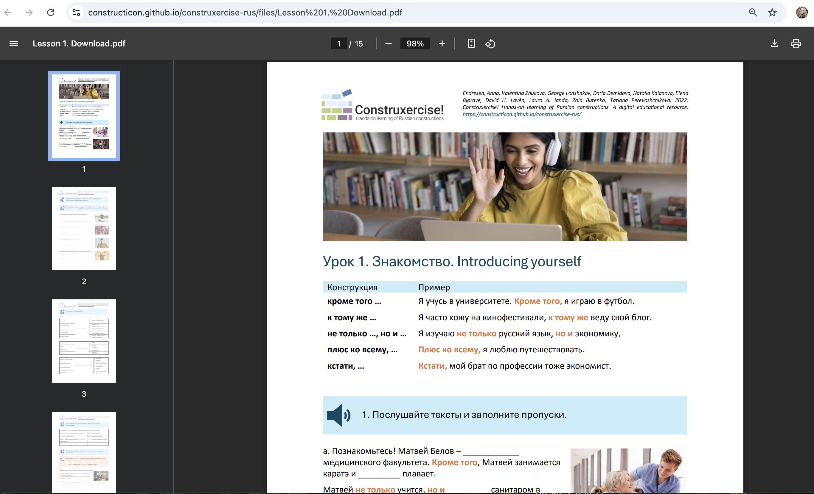
The user can download a printable version of each lesson from the website.

Slide 75
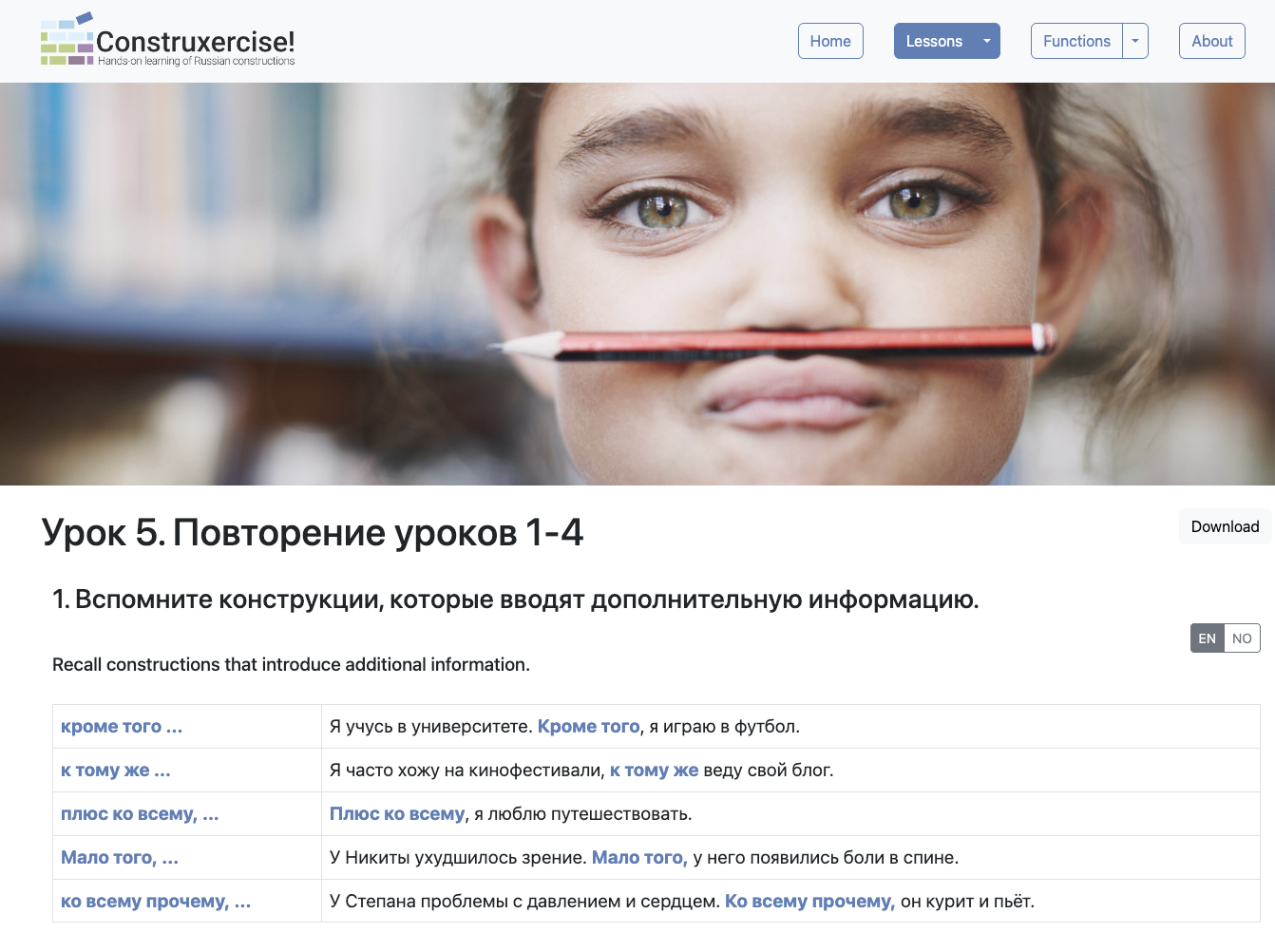
Review lessons systematize constructions across their functions
Constructions that introduce additional information.
Exercises on how to choose among them.

Slide 76
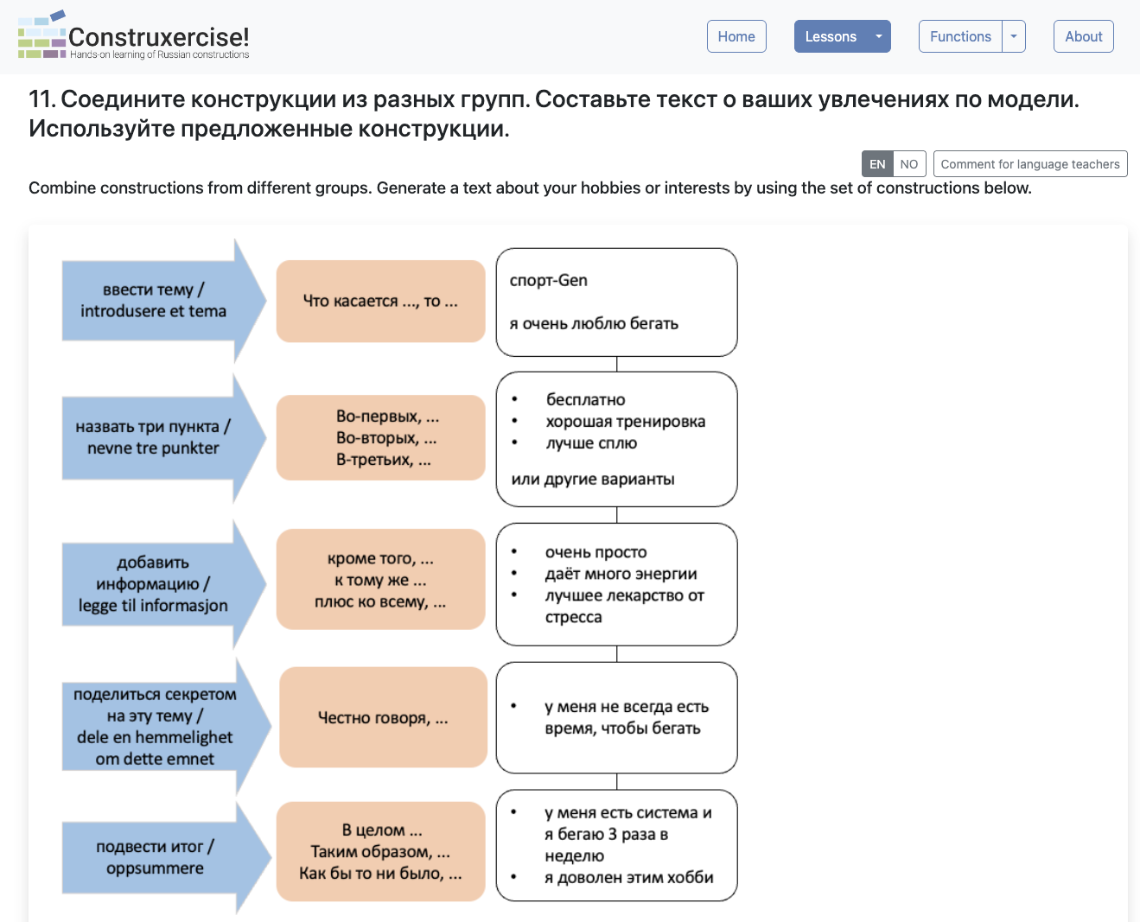
Discourse functions
constructions to choose
lexical fillers
Target constructions can be combined into
strategic sets, or templates
Such templates can be employed for producing texts for potentially any topic and genre
Notes:
Упражнения на комбинации конструкций и выстраивание связного последовательного текста
In review lessons, constructions are combined in strings to yield templates for text organization at the micro-level. Such templates can be employed for producing texts of potentially any topic and genre. building blocks with combinations KEEP producing texts of potentially Сxns can be combined into strategic sets, or templates, that make the task of generating any text, oral or written, much easier.

Slide 77
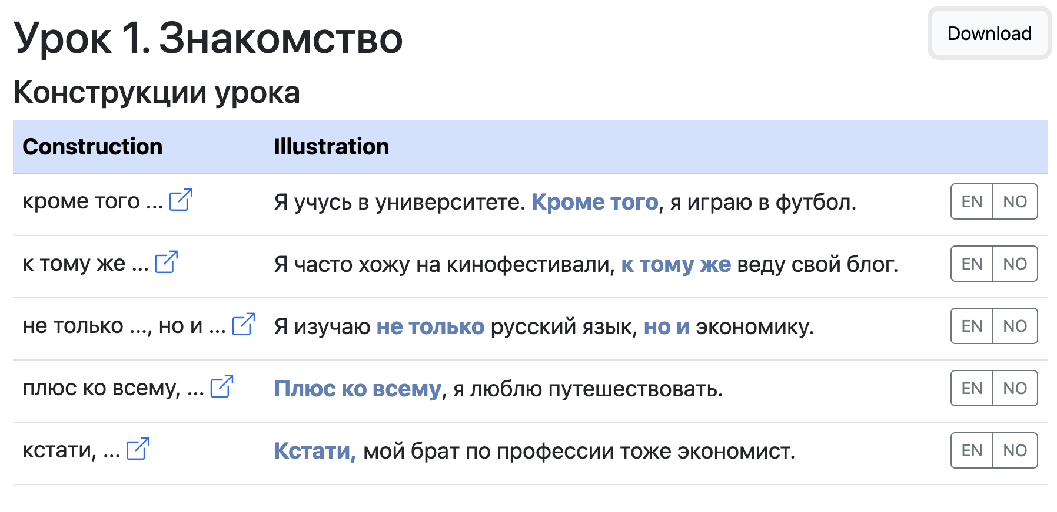
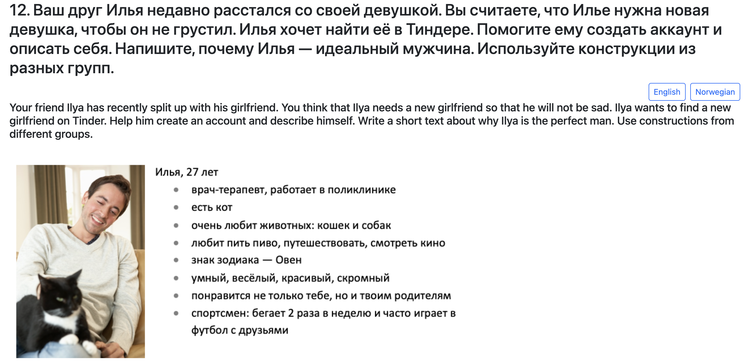
Structure of a lesson:
Overview table of target cxns: 5 to 6 cxns
2-3 microtexts, in which nearly every sentence contains a target cxn.
Most exercises and texts are short.
Each lesson takes about 60 min to complete.
Main body:
a series of 12–15 exercises
Each lesson culminates with exercises
that engage students in producing
a dialogue or monologue using target cxns
Notes:
Each lesson opens with an overview table of cxns followed by 2-3 microtexts, in which nearly every sentence contains a new construction. Each lesson culminates with exercises that engage students in producing a dialogue or monologue using newly learned constructions and key words.
voiceover
logic in each lesson, from easy to more advanced, from linguistic to more spoken communicative

Slide 78
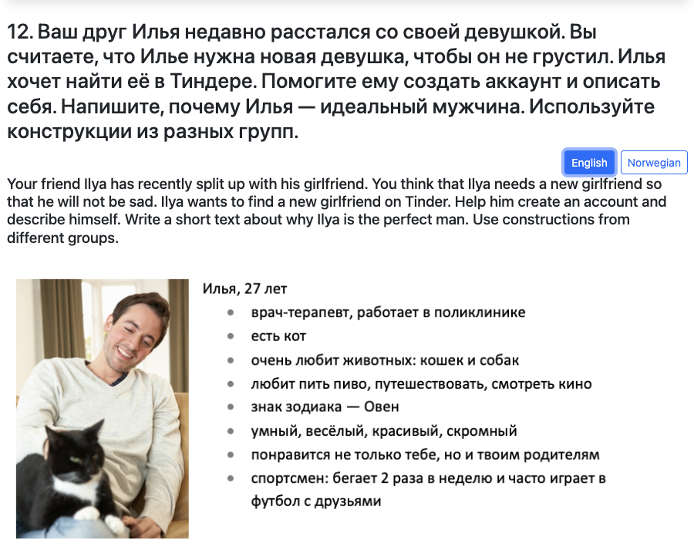
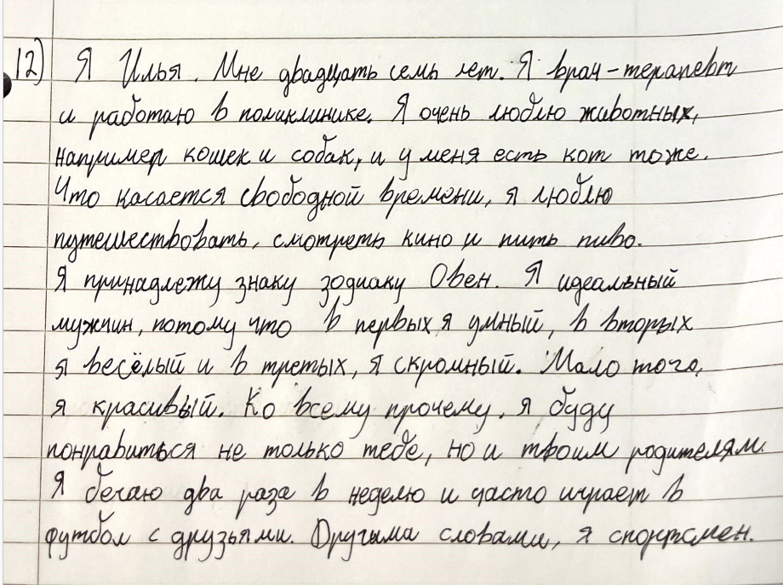
Students learn constructions and produce more natural and fluent texts.

Slide 79
Students learn constructions and produce more natural and fluent texts.

Slide 80
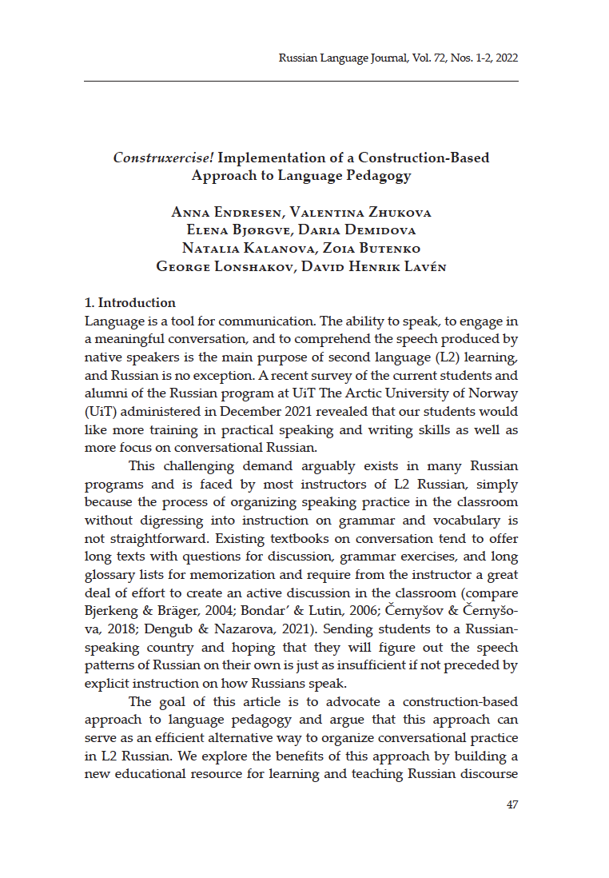
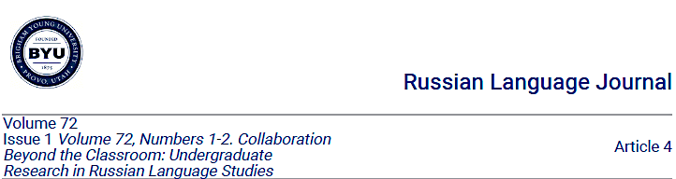

Launch of a new educational resource for learning Russian
More details in our article:
Endresen, Anna, Valentina Zhukova, Elena Bjørgve, Daria Demidova, Natalia Kalanova, Zoia Butenko, George Lonshakov, David Henrik Lavén. 2022. “Construxercise!: Implementation of a construction-based approach to language pedagogy”. Russian Language Journal 72(1). 47-71. Available at: https://scholarsarchive.byu.edu/rlj/vol72/iss1/4

Slide 81
Further directions

Slide 82
Further directions
Quantitative clustering of constructions within languages
Languages with multiple and flexible norms, dialectal variation, e.g. Norwegian
Establish separate identities of languages, e.g., Ukrainian is not a version of Russian
Multilingual constructicons, comparative concepts
Expand use of AI to assist in building of constructicons
Constructicons can facilitate training and improvement of LLMs
Language testing: constructions can define proficiency

